Slide 1
MYLEGION OVERVIEW
Register a MYLEGION account to view and manage membership for The American Legion and Sons of the American Legion.
MyLegion includes Officer administrative tools, reports, and member management.
Notes:
Title Slide: MyLegion Overview

Slide 2
MYLEGION:
REGISTER AN ACCOUNT
Register a MYLEGION account to view and manage membership for The American Legion and Sons of the American Legion.
2026
Notes:
Title Slide: Register an Account

Slide 3
ABOUT MYLEGION
MYLEGION is an American Legion website for Legion and Sons of the American Legion members.
One account provides all LGN and SAL membership details and administrative tools.
All accounts are individual. Post and Squadron membership is accessed through the individual MyLegion account. Do not share your UN and PW.
Email must be on your membership record on file at National HQs. Registering with an email not listed as your primary email will not provide access to membership details or leadership resources.
Notes:
MyLegion is an American Legion website for Legion and Sons of the American Legion members.
<1> Membership details for both The American Legion and Sons of the American Legion are included in one account, along with any administrative tools and resources provided to adjutants and commanders.
<2>All accounts are individual. Post and Squadron membership is accessed through your individual MyLegion account. Do not share your username and password with others.
<3>The Email used during registration must be on your membership record prior to registration. Registering with an email not listed as your primary email will not provide access to membership details or leadership resources.

Slide 4
BEFORE YOU REGISTER
Do you have an email address on your membership record?
Email browser should be open to receive a onetime password (OTP) during registration.
Be prepared to create a password that meets the requirements below:
One Uppercase Letter
One Lowercase Letter
One Number
One Symbol (!@#$%^&*)
Eight character minimum
Notes:
Before registering an account, you may want to verify your email address is correct on your membership record with your post or department leadership. All MyLegion accounts are to be registered with the primary email address. Registering without an email on your membership record will create an account with no member details. Before registering an account, you may want to verify your email address is correct on your membership record with your post or department leadership. All MyLegion accounts are to be registered with the primary email address. Registering without an email on your membership record will create an account with no member details.
<1> Open your email browser to receive an email that will be sent. During registration, a one-time password is sent to complete registration with email verification.
<2>Be prepared to create a password. Password requirements include: <3> 1 Uppercase letter, 1 Lowercase letter, 1 Number, 1 symbol, and have an eight (8) character minimum.

Slide 5
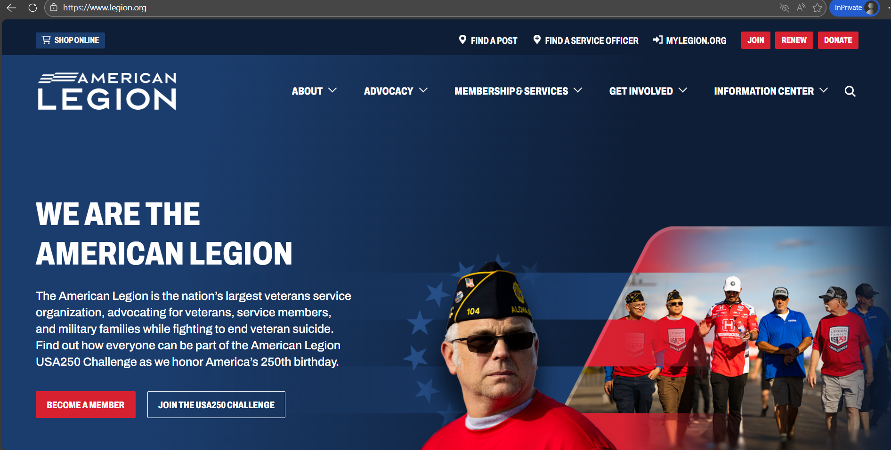

LEGION.ORG
Notes:
The American Legion National website is legion.org. Located at the top of the page is a link for MyLegion.

Slide 6
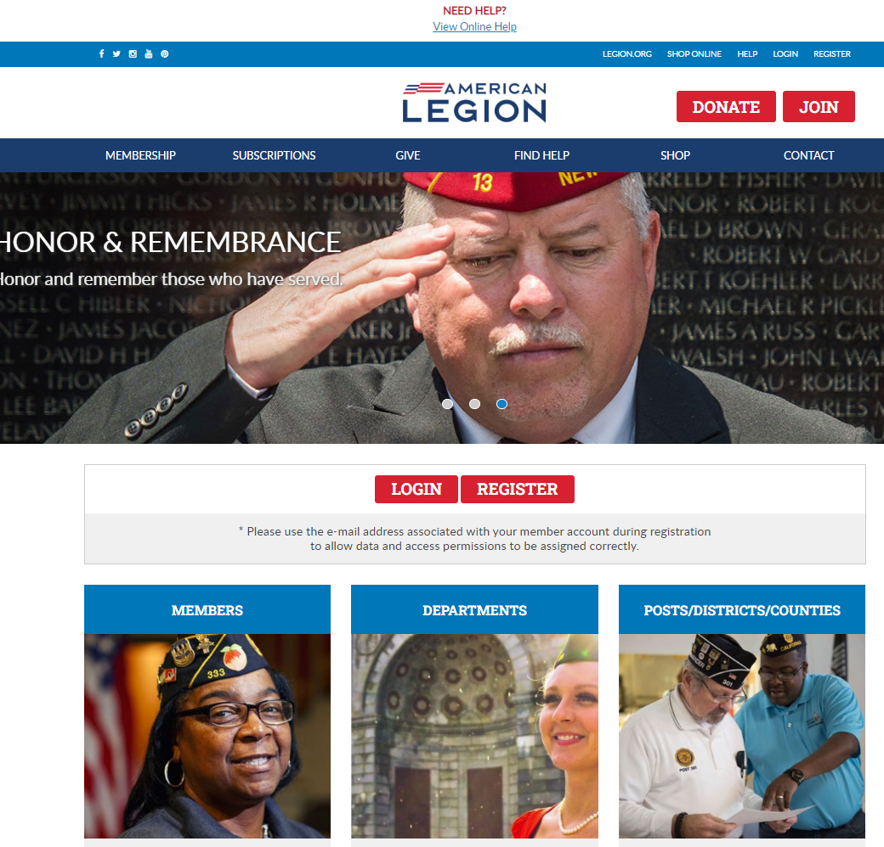
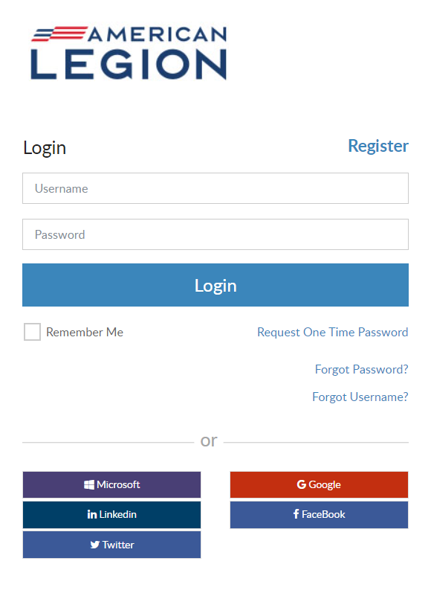

Notes:
In the upper right, click Register. <1> Notice, there may be additional places to access the same tool. Log in and register is also located in the middle of the page. Begin registration by entering your primary email address.

Slide 7
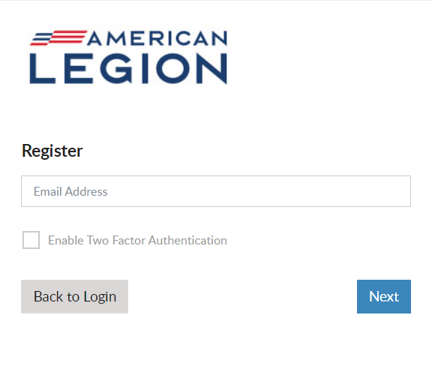
REGISTRATION
Email address is required to register.
Open Email browser to retrieve verification code.
No Email? Go back and contact local or department leadership prior to registering an account.
Do not use an email shared by another individual or group of individuals.
Notes:
Enter your email address and click Next. An email is required. Remember to have your email open during registration to receive a verification code after this step.
<1> If you do not have an email address do not proceed. Exit the site and contact your post adjutant, department headquarters or national customer service to add an email to your record prior to registering an account.
<2> Do not use an email shared by another individual or group of members.

Slide 8
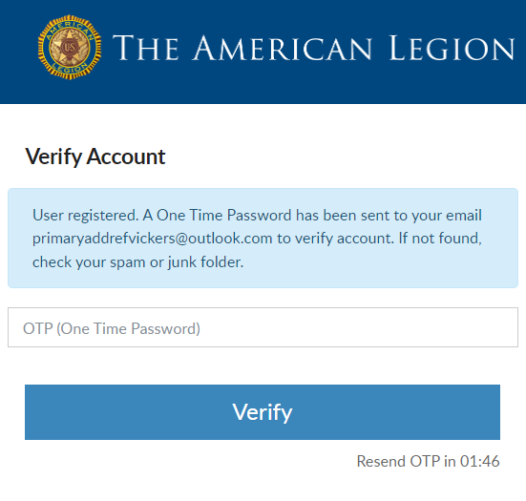
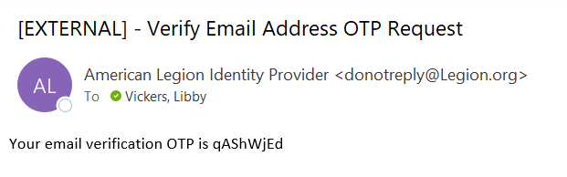

VERIFY ACCOUNT
Do not close this window. Go to your email to retrieve the OTP.
2 minutes to complete.
Notes:
A Verify Account window opens to verify you have access to the email address.
Do not close this window. Return to your email to retrieve a one-time password. <1> This message comes from The American Legion Identify Provider. Check your Spam or Junk folders if you do not see the message within 10-15 seconds. The email will be sent immediately. <2> There is a 2-minute time allotment to enter the one-time password and verify. It the time expires you will see a message to request another OTP. This step ensures that you have access to the email associated with this account.

Slide 9
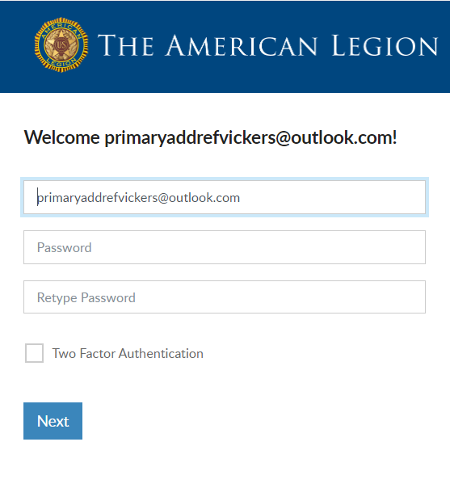
USERNAME AND PASSWORD
Username defaults to email address.
Create Password.
Two Factor Authentication.
Password Requirements:
Uppercase Letter
Lowercase Letter
Number
Symbol (!@#$%^&*)
8-character Minimum
Notes:
Members will receive a welcome window to complete the final step, create a password.
The username defaults to the email address entered. It is recommended to leave the email address as your username. However, you can update the username in this window by updating it in the Username field. When creating a username, try to use something unique.
<1> Create a password using the following criteria: 1 upper and lowercase letter, 1 number, 1 symbol or special character and a minimum of 8 characters in total.
<2> Two-factor authentication is an extra layer of security to ensure that you're the only person who can access your account, even if someone knows your password. This extra security measure requires you to verify your identity using a randomized code we’ll email you each time you attempt to log in. Applying this feature is available when you first create your account. It can be added or removed later through your account.
Click “Next” to proceed.

Slide 10
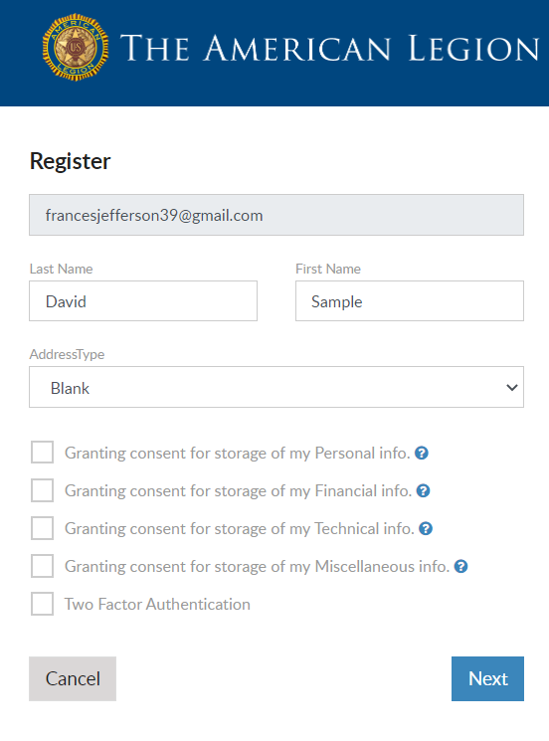


CAUTION
LGN and SAL members do not proceed if you receive this window.
Email entered does not match what is on member record.
Contact local or department leadership to verify email on file.
primaryaddrefvickers@outlook.com
Notes:
Members of The American Legion and Sons of the American Legion should not proceed if this window appears asking to grant consent. Continuing will not connect to your membership details.
<1>The email address entered must match what is on file at national headquarters. Members should double-check how the email address was entered. Was it entered correctly? If not, cancel and try again. <2> If it is entered correctly, click Cancel and contact your local or department leadership or national customer service to update your primary email address.

Slide 11
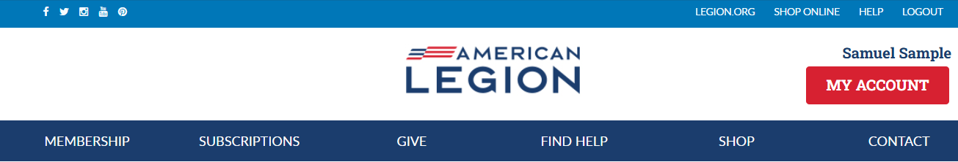
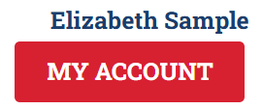
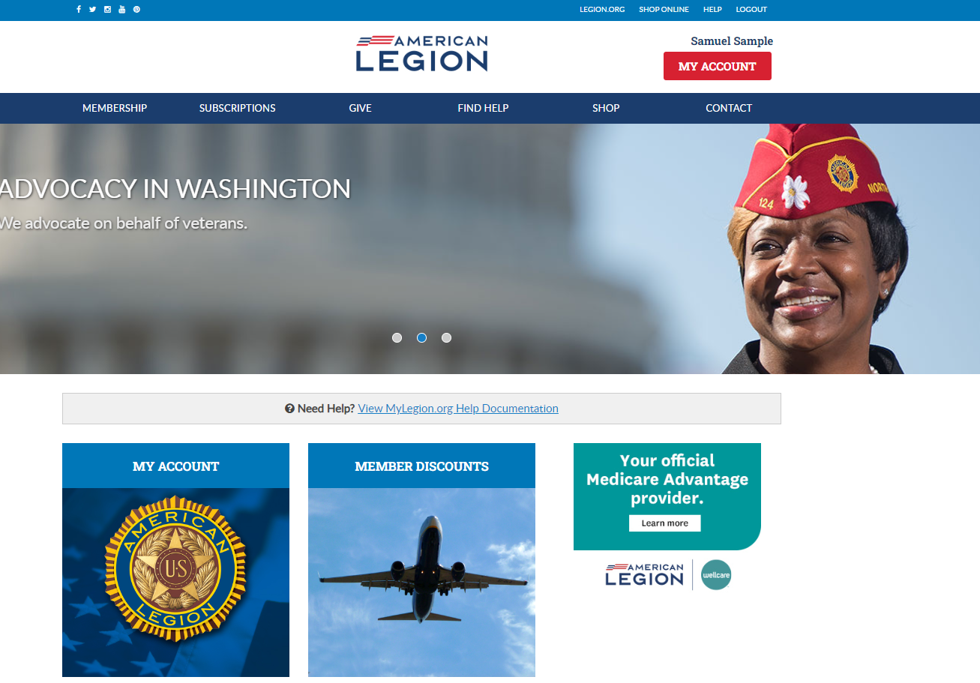
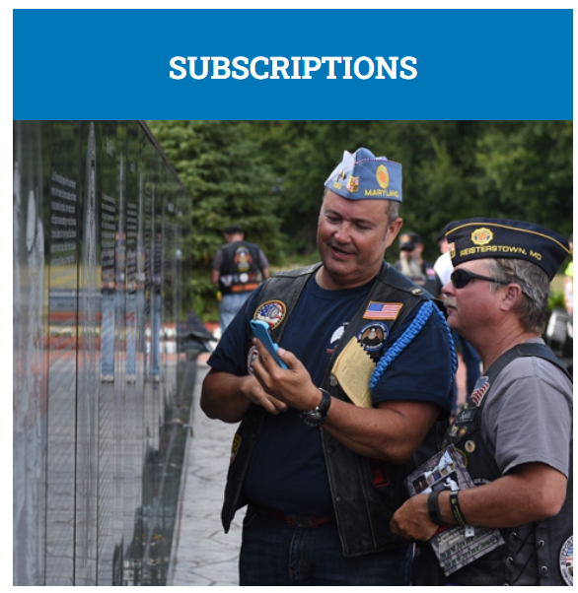
Notes:
When registration is complete, MyLegion opens displaying your name located above the MY ACCOUNT button.

Slide 12
MEMBER INFORMATION AND RESOURCES
Notes:
Title Slide: Member Information and Resources

Slide 13
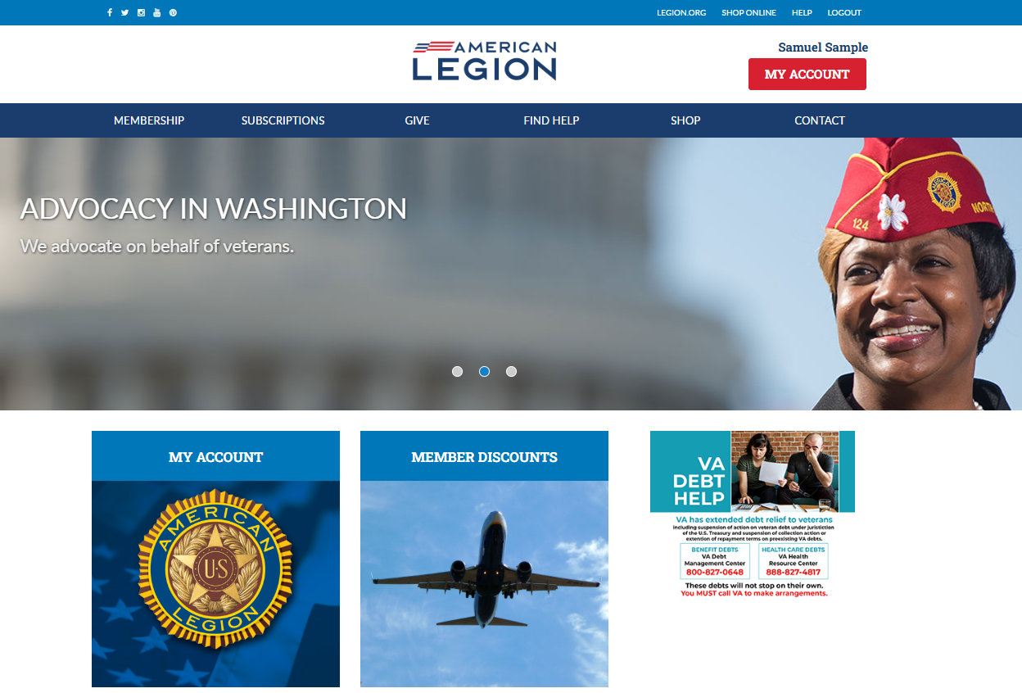
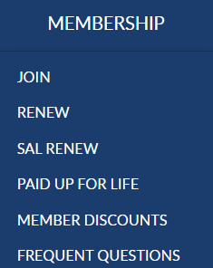
Notes:
From the MyLegion home page you will find menus that include links to membership, subscriptions, donations, help resources, Flag & Emblem and contact information.
Membership links include online join for Legion members only, online renewal, and Paid Up for Life information. Paid Up for Life is a national program for Legion members only. Use these links to view member discounts, and frequently asked questions about membership eligibility.

Slide 14
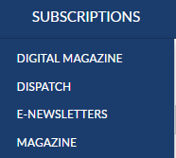
Notes:
Membership in The American Legion includes The American Legion Magazine in digital format from the Subscriptions menu, a link to monthly Dispatch articles and set up options for online E-Newsletters.

Slide 15
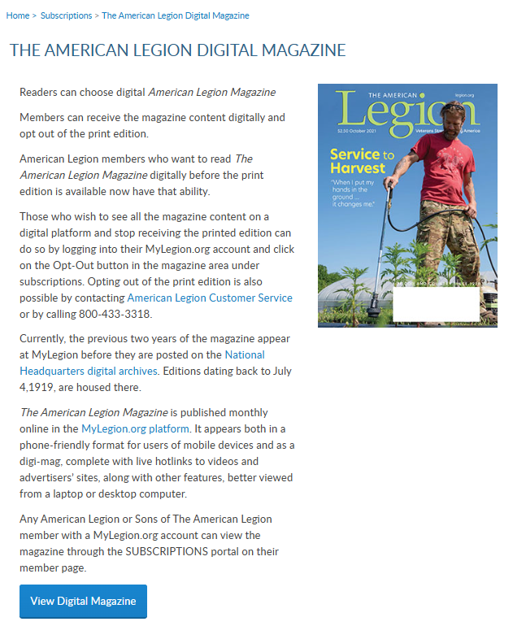
Notes:
Digital magazine provides contact information for national staff to assist with opting in and out of digital magazine subscriptions.
You will also find the link to request past publications through National Headquarters digital archives.

Slide 16
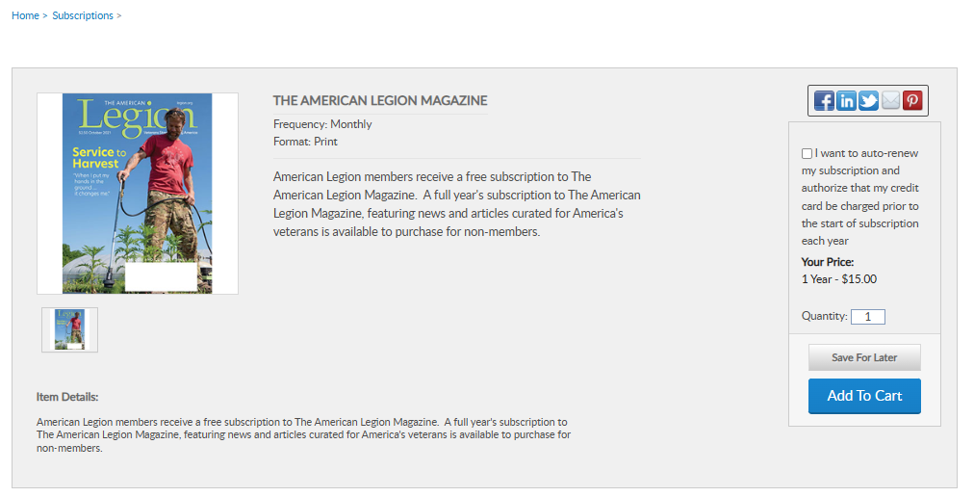
Notes:
The Magazine option at the bottom of the list provides a link for non-members to purchase and renew their subscription or members to purchase additional subscriptions.

Slide 17
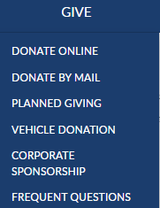
Notes:
Online giving opportunities can be set up through a MyLegion account. The give menu provides information about planned giving, vehicle donations and corporate sponsorships. Questions about giving to American Legion charities are answered in frequent questions.

Slide 18
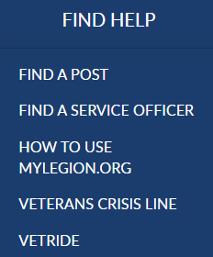
Notes:
Resources help you find a post or accredited service officers with step-by-step help documentation to assist with MyLegion tools for members and leadership. Links to veteran’s crisis line and Vet Ride are also available.

Slide 19
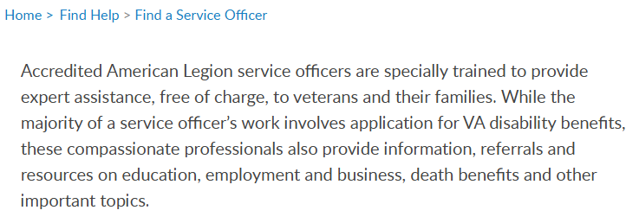
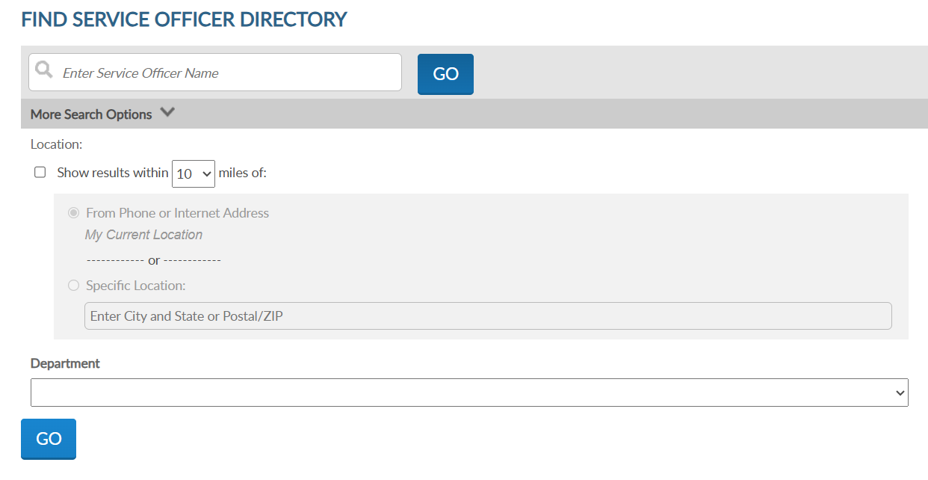
Notes:
Using the service officer directory, you can enter your state and distance to find one near you.

Slide 20
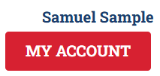
Notes:
The Shop link navigates to National Flag & Emblem and Contact re-directs to legion.org’s National HQ directory.
To view membership details and manage your account click on My Account. <1>

Slide 21
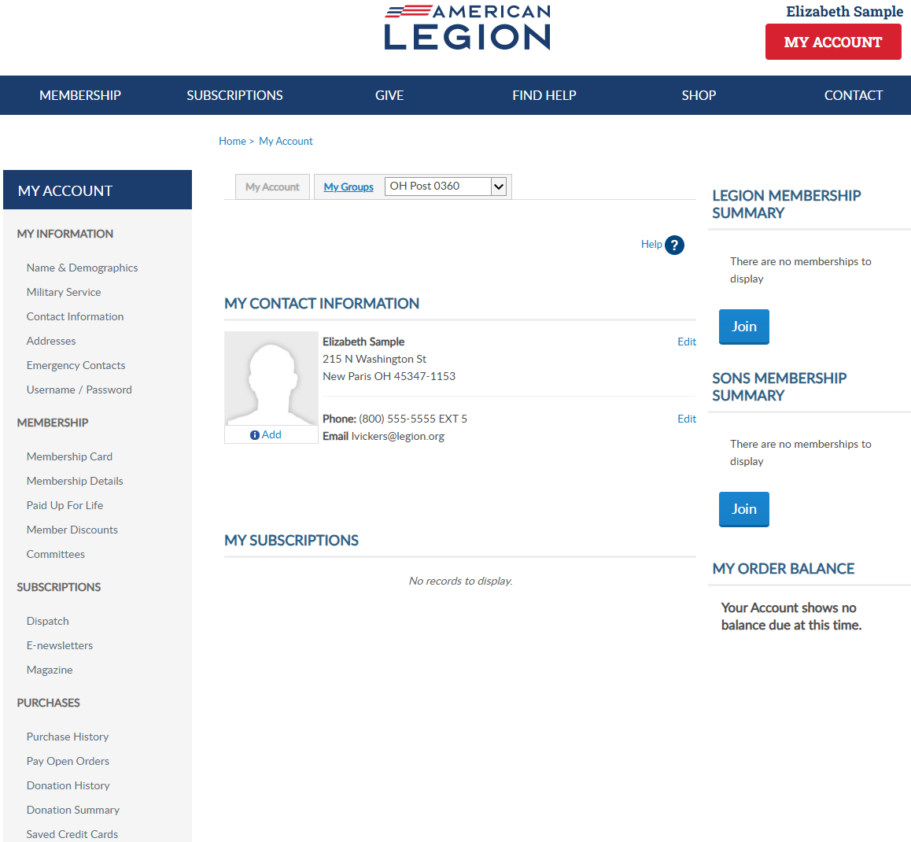
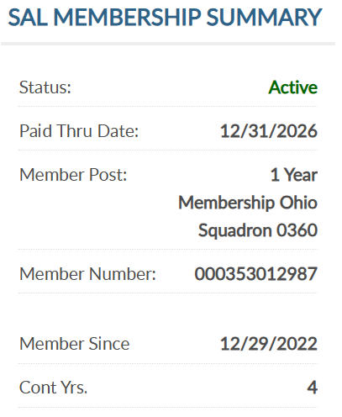
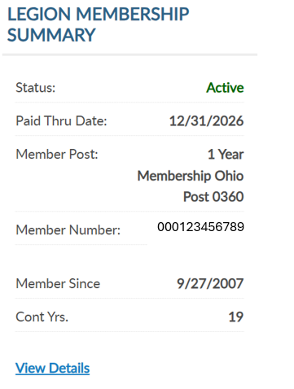
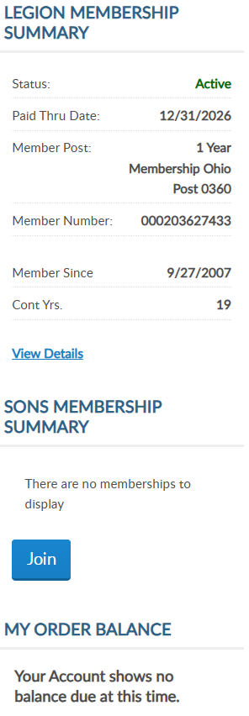
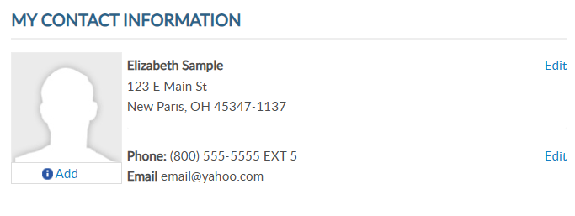
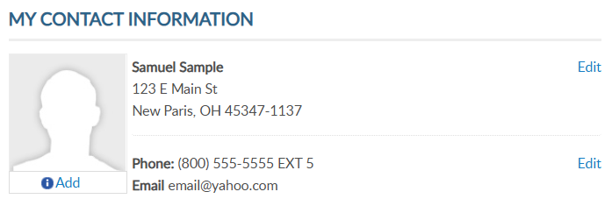
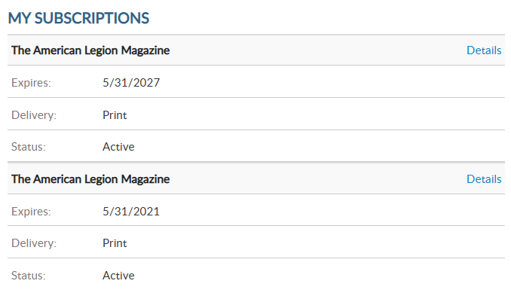


000123456789
000123456789
000123456789
Notes:
My Account provides membership detail summaries for American Legion and Sons of the American Legion membership. <1> It include member status, renewal status, post and squadron number, member ID, join date and continuous years. Members of both The American Legion and SAL are known as dual members and will have the same membership ID#.
When a renewal is available the renew now button will display. To renew, click the renew now button.

Slide 22
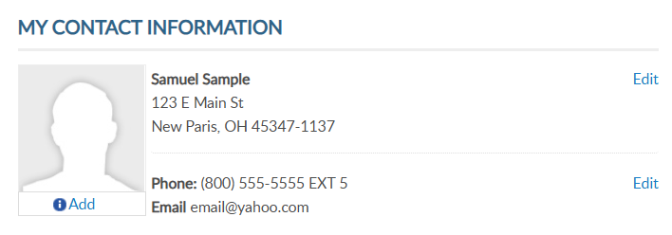
MY CONTACT INFORMATION
Primary Contact Info
Mailing Address
Phone Number
Email Address
000123456789
000123456789
Notes:
Primary contact information is found in the center of the page. You can also edit your primary mailing address, phone number and email address. You cannot edit your name in this area. Name updates can be made using the left menu option Name and Demographics.

Slide 23
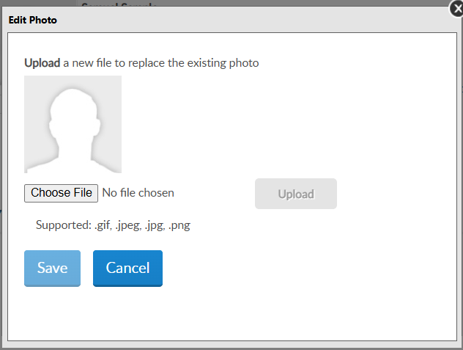
PROFILE IMAGE
Add Image
000123456789
000123456789
Notes:
To add an image to your record, click “Add” in your profile. <1>You will be asked to choose a file. Click on “choose file” to open saved images. Note, only specified file types are supported.

Slide 24
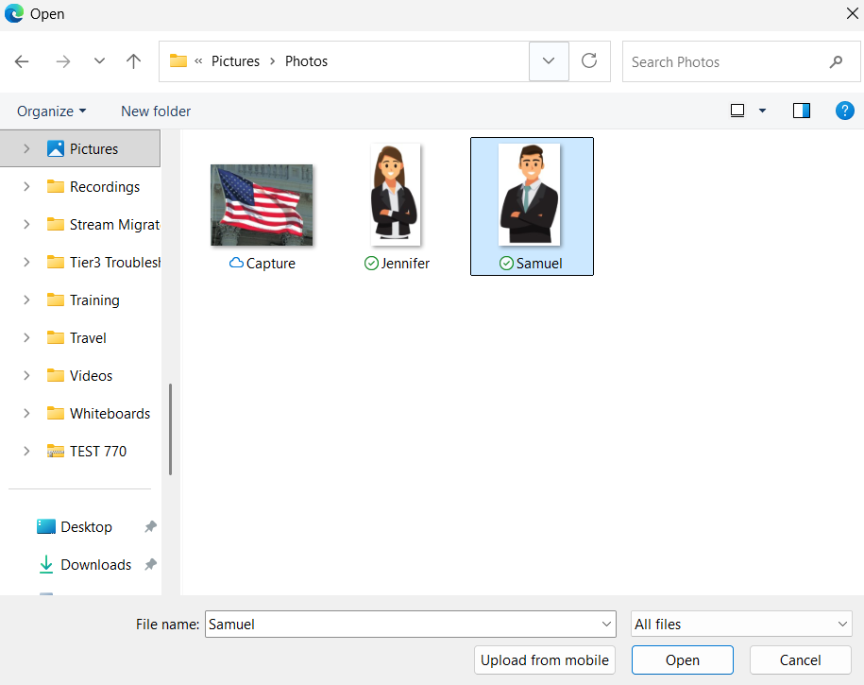
PROFILE IMAGE
Add Image
Choose file and click on image. Click “Open”.
Notes:
Once you locate the image, click on the image and select “Open”.

Slide 25
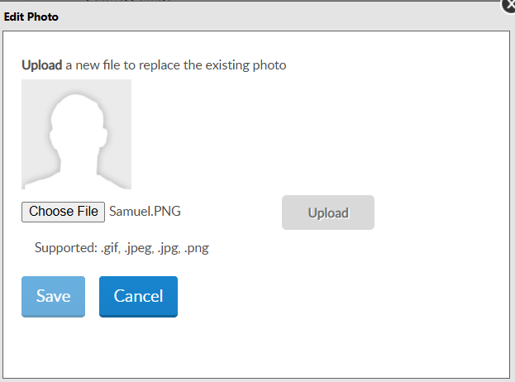
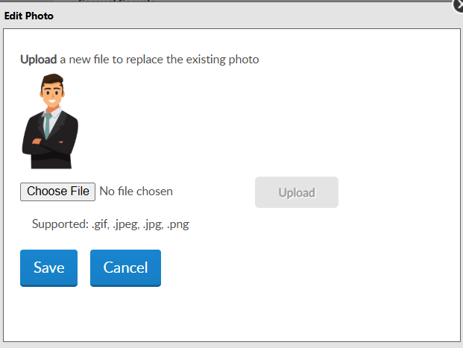
File name appears.
Click “Upload”. Preview image and “Save”.
PROFILE IMAGE
Notes:
The next step is to upload the file. After the file upload it appears for review. Click “save” to add the image.

Slide 26
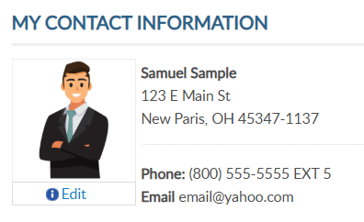
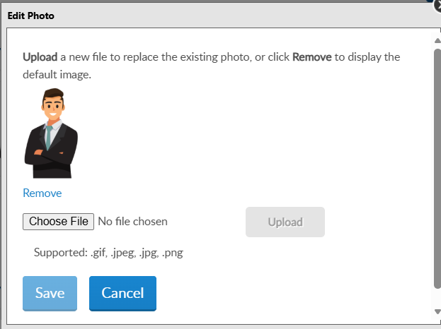
IMAGE
Edit/Remove Image
000123456789
000123456789
Notes:
Images can be updated or removed. Click edit below the image. <1> Choose another file to replace or click “remove” to delete the image from your record.

Slide 27
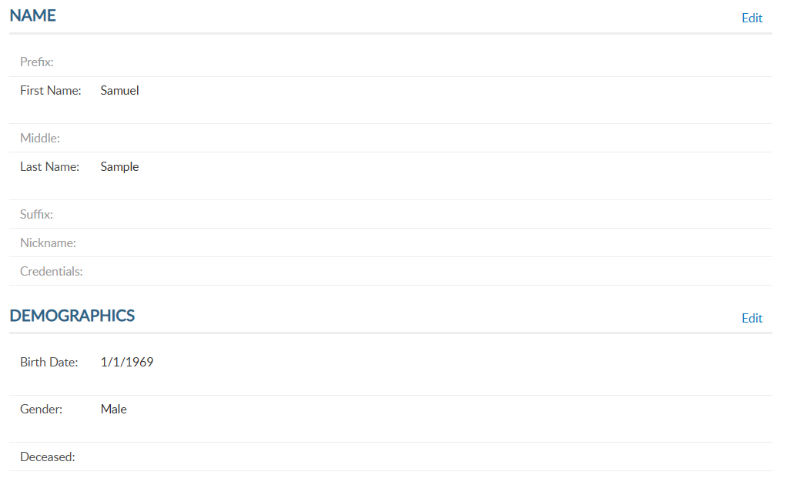
000123456789
000123456789
Notes:
Name and demographic information allows you to update your name, date of birth and gender. If you notice your record is flagged as deceased in error, contact our department headquarters. From the left menu, select Name & Demographics to open the window.
There are 2 sections in this area. Each has an Edit option. Let’s look at the demographics section. Click edit to the right of demographics.

Slide 28
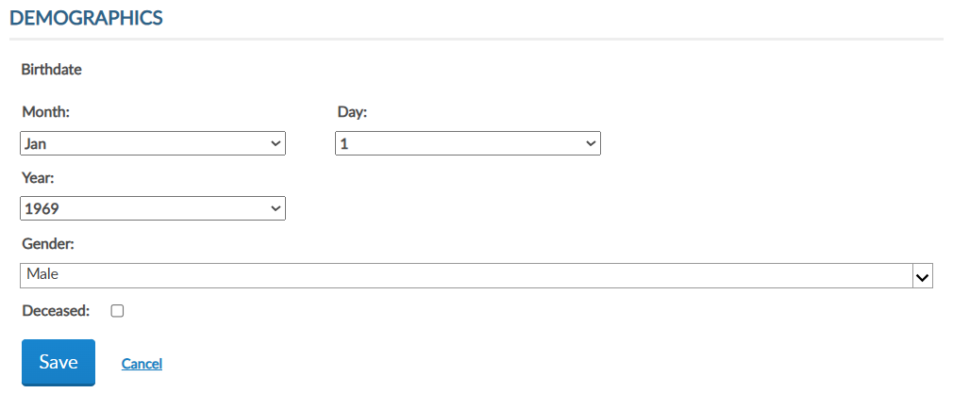
EDIT DEMOGRAPHICS
Notes:
Enter updates and save. Checking the deceased box will change member status to deceased. Deceased status will stop renewal notices, publications and subscriptions and end any committee assignments.

Slide 29
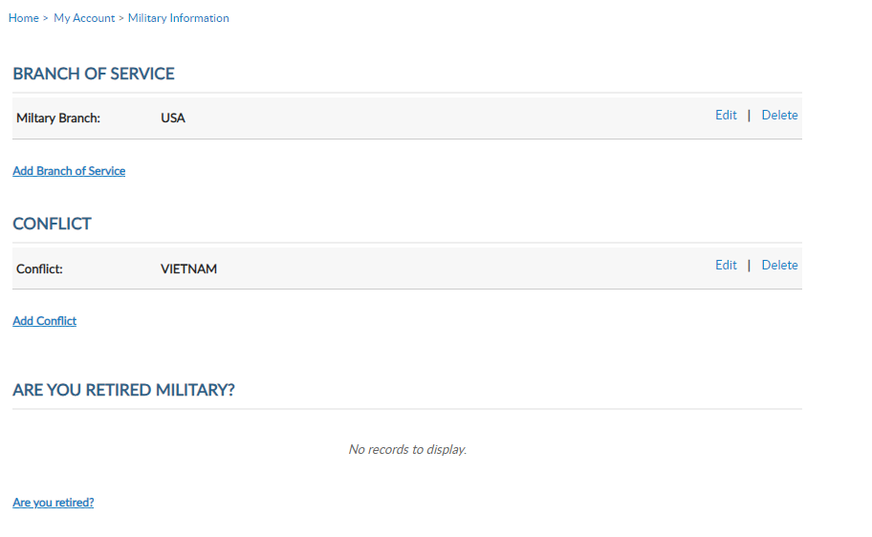
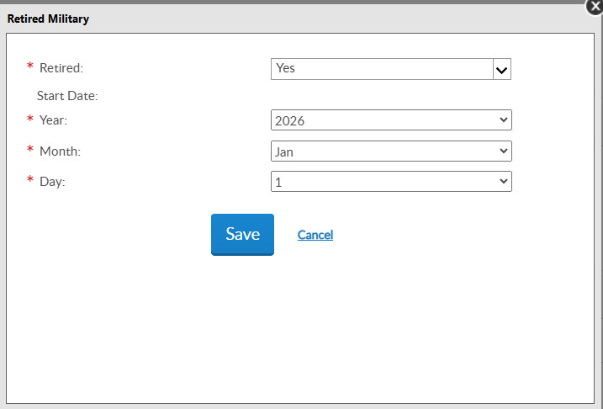
000123456789
000123456789
Notes:
Military service provides branch of service, conflict and retirement information and are required fields for Legion members. Using the Add, Edit or Delete links you can manage this information. Members can list multiple branches and conflicts.

Slide 30
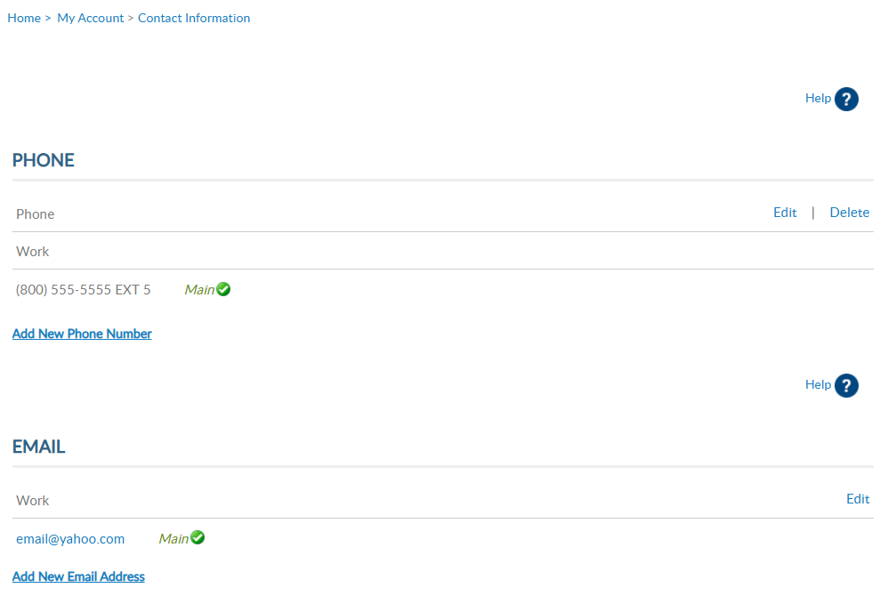

000123456789
Updating your primary email address does not change your username.
000123456789
Notes:
To add or remove alternate phone number or email address you must use the left menu item “Contact Information”.
Main contact information is listed on leadership rosters and reports. Use the add, update and delete links to maintain your contact information.
All phone numbers and emails will display in this window. Notice the email address does not have a delete option. Main email address information cannot be deleted. To update your email address, select the edit button. It is required to have a main email address on your membership record to have a MyLegion account.
If you are currently using your email address as your MyLegion username, updating the main email does not update your username. It does update the email associated with your account. Any future username or password requests will be sent to the primary email address on file.

Slide 31
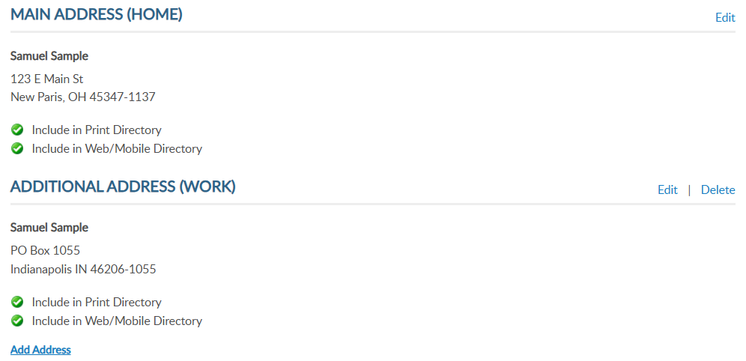
000123456789
000123456789
Notes:
Addresses allow you to add an alternate address and set address preferences. Information set as Main is the primary contact information and cannot be deleted.
Only one main contact can be assigned. You can add alternate address information for subscriptions and committee communications.

Slide 32
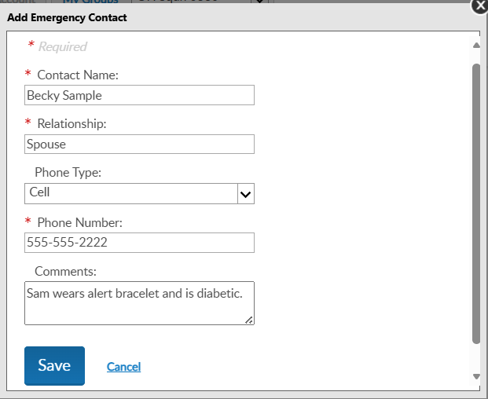
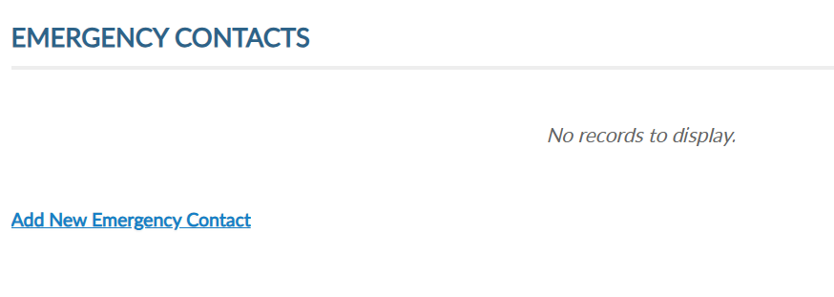

000123456789
000123456789
Notes:
Emergency contact information can be useful in case of an emergency if you are attending a convention, event, or visiting your local post.
Add single or multiple contacts and designate the priority of who to contact via phone. <1> Click “Add New Emergency Contact”, enter data and save.
You can add multiple contacts or delete/edit as needed.

Slide 33
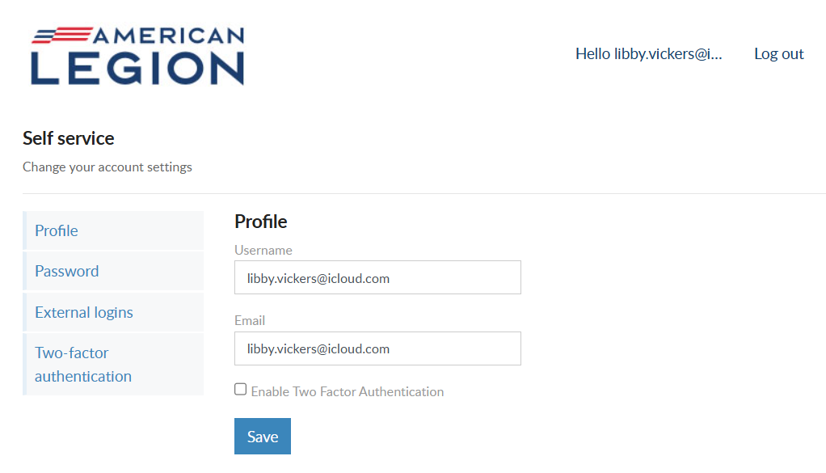

000123456789
email@yahoo.com
email@yahoo.com
000123456789
Notes:
Username/Password allows users to update log in credentials. This link opens a self-service window that shows your current username and primary email associated with your account.
Notice a new tab opens in your browser. When complete with reviewing or updating information, close the tab to return to your MyLegion account.
Your account profile includes username and primary email address. MyLegion accounts are associated with the primary email address on file. Your username does not have to be an email address but is recommended.
The email address listed in the self-service window is the primary, or main email address. Updating the email in Username/Password directs all future forgot username and passwords to this email.
You can also enable or disable 2 factor authentication from this window. Enter new information and save.

Slide 34
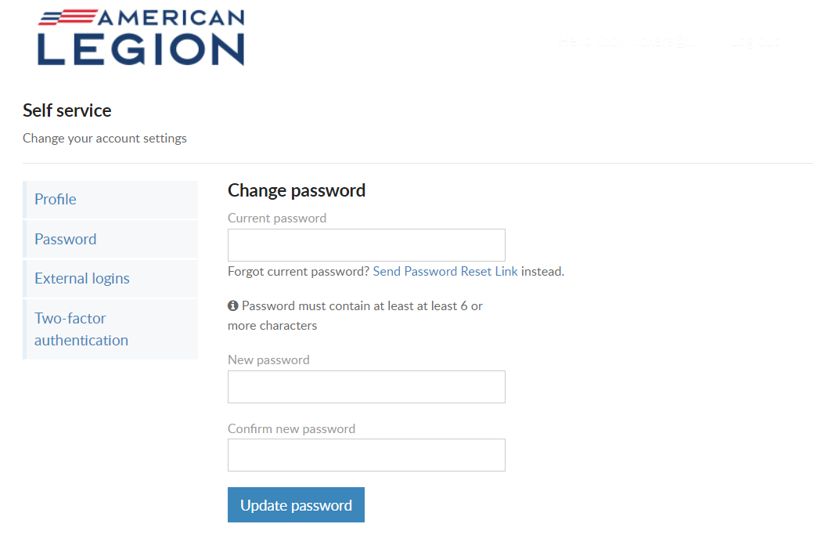
USERNAME & PASSWORD
Password
Current PW required
Must include:
1 Lowercase Alpha
1 Uppercase Alpha
1 Number
1 Symbol
8 Character Minimum
Notes:
To update your password in the self-service window you must know your current password. If you have logged in with a saved password and do not know it, use the “Send Password Reset Link” where a link will be sent to your primary email address.
If you know your current password, enter it with the new password and click ‘Update Password’.
Password requirements include: 1 Uppercase letter, 1 Lowercase letter, 1 Number, 1 symbol, and have an eight-character minimum.

Slide 35
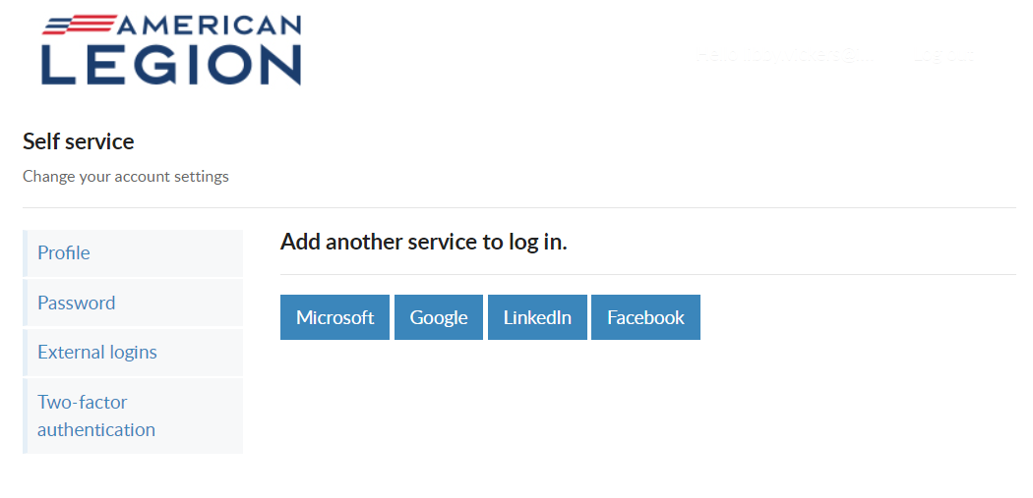
USERNAME & PASSWORD
External Logins
Notes:
Like many other web applications, myLegion users can log in using other online identities as a single sign on process. Allowing fewer passwords to remember.

Slide 36
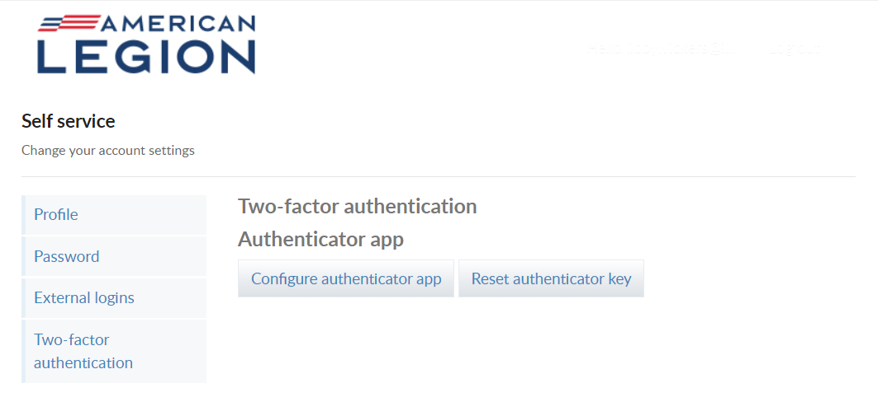
USERNAME & PASSWORD
Two-Factor Authentication
Notes:
Two-factor authentication is an extra layer of security to ensure that you're the only person who can access your account, even if someone knows your password. This extra security measure requires you to verify your identity using a randomized code we'll send you each time you attempt to log in.
If you set up 2 factor authentication, you can disable through self-service.

Slide 37

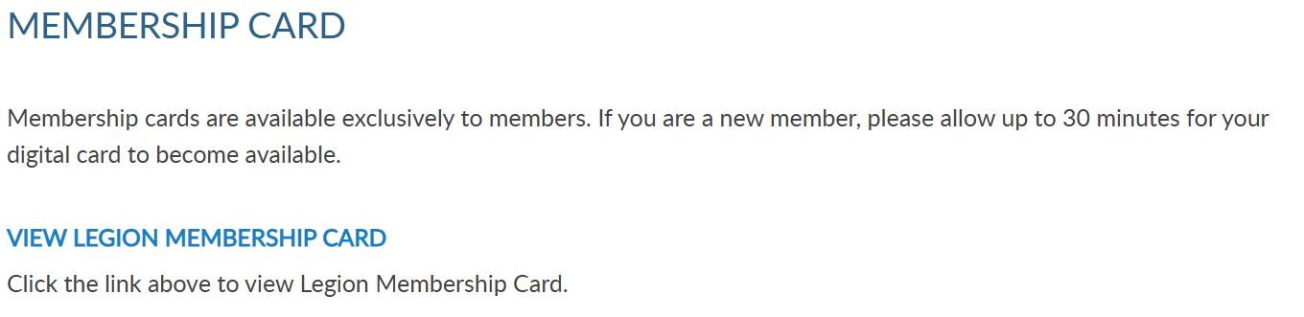
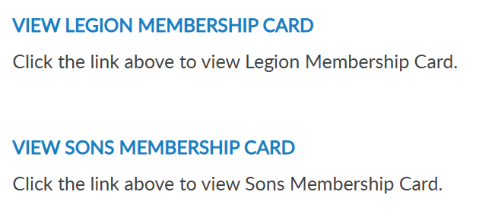

000123456789
000123456789
Notes:
To print your membership card, go to Membership Card.
If you are a new member, please allow up to 30 minutes for your digital card to become available.
Legion and Sons of the American Legion membership cards can be printed. Only current membership cards are available. Legion and Sons of the American Legion membership cards can be printed. Only current membership cards are available. Click the link for the card to print.

Slide 38


MEMBERSHIP CARDS
123456789
19
SAMUEL SAMPLE
Notes:
The card is available to print or save from your web browser. A pdf document will open in your browser to save or print.<1>

Slide 39


000123456789
000123456789
Notes:
View membership status and manage automated renewal in Membership Details.
MyLegion allows you to set up auto renewal. Members set up for auto renewal will have their credit cards charged and do not receive renewal notices. Auto renew is available for both American Legion and Sons of the American Legion members. You will have to set up each auto renewal separate if you are a dual member.
A credit card must be saved prior to setting up auto renewal. Credit card information is stored in Saved Credit Cards.

Slide 40

000123456789
000123456789
Notes:
The Paid Up For Life opens the paid up for life application for Legion members.

Slide 41

WELCOME BACK SAMUEL!
Samuel Sample
(800) 555-5555 EXT 5
Samuel Sample
email@yahoo.com
123 Main St
Notes:
The application provides a quote to purchase or set up a time payment plan.

Slide 42


000123456789
000123456789
Notes:
The American Legion offers exclusive discount programs for members of The American Legion and Sons of the American Legion. Discount provider information and codes are only available to members.
Discount codes are found only when logged into myLegion or legion.org. Select the area of interest to view provider contact information and exclusive discount codes.

Slide 43


000123456789
000123456789
Notes:
Committees list current, future and past positions reported to national headquarters. Missing information regarding your officer history can be clarified through your department headquarters.

Slide 44



000123456789
000123456789
Notes:
Dispatch is an American Legion National Headquarters monthly online newsletter that provides post, district and department leaders with news relevant to membership, post activities and national American Legion news.
A monthly Digital Dispatch e-newsletter is sent directly to subscribers’ email inboxes. The e-newsletter features headlines with clickable links to the full stories on the Digital Dispatch web page, www.legion.org/dispatch.

Slide 45



000123456789
000123456789
Notes:
E-newsletters allows you to opt in or out of online subscriptions. There are 3 sections. Flag & Emblem, Media, and Membership.
Check the box to select individual subscriptions. Unless specified these subscriptions will be emailed to the main email address on file.
Once all options are selected, save changes.

Slide 46


000123456789
000123456789
Notes:
Members receive a 12-month free subscription to The American Legion Magazine. This publication has gone digital. Current and past issues for 2 years are in your My Account subscriptions menu. To view past issues, go to archives using the upper menu Magazine option.
Expired members will receive an Access Denied message. Access to online magazine requires active American Legion, Sons of the American Legion membership, or paid subscription.

Slide 47



Samuel Sample
000123456789
Samuel Sample
000123456789
Samuel Sample
Notes:
Purchase history shows current open orders and history of payments made for membership and subscriptions. Expand the date range to view past payments.

Slide 48

000123456789
000123456789
Notes:
Donation history provides a date range search to view donations made to American Legion Charities.

Slide 49

000123456789
000123456789
Notes:
Members can enter, maintain, and save credit card information for auto renewal, donations, and purchases.
If no card is stored, you can add one. Go to add New Card, enter card information and Save.
At any time, you can update, remove or add another card.

Slide 50

MY ACCOUNT & HELP RESOURCES
000123456789
000123456789
Notes:
Learn more about MyLegion using “Find Help” and go to How to use MyLegion.org.

Slide 51
MYLEGION: Understanding My Groups
Understand group management. View and email members, global member search, view group attributes and services, and review officer materials.
2026
Notes:
MyLegion is The American Legion’s membership website. Through MyLegion, members of The American Legion and Sons of the American Legion can view and manage their membership on file at National Headquarters. Adjutants and commanders, through their individual accounts, will have a My Groups area to assist with post and squadron administrative tasks.

Slide 52


Adjutants, commanders and assigned admins will have a MyGroups menu.
MYLEGION.ORG
No group menu? Contact your department headquarters.
000123456789
000123456789
Notes:
MyLegion first displays information about your membership for both The American Legion and Sons of the American Legion.
Adjutants, commanders and assigned administrators will have a My Groups menu. My Groups is the administrative side of myLegion available to. <1> If you do not have a My Groups menu and are a current adjutant or commander, contact your department headquarters.

Slide 53
GROUP | ADMINISTRATIVE OFFICERS
Post Post Officer | Post Adjutant & Commander
Squadron Squadron Officer | Squadron Adjutant & Commander
County County Officer | County Adjutant & Commander
District District Officer | District Adjutant & Commander
Detachment Detachment Officer | Detachment Adjutant & Commander
Department Department Officer | Department Adjutant & Commander
GROUP DEFINITIONS
Officer Groups are View Only
View Only
View Only
Notes:
Groups are defined as a post, squadron, county, district, detachment and department. Adjutants and commanders have My Groups by default.
With each group, adjutants and commanders will have an officer’s group. Officer groups provide a list of current and future officers. It is not the group to select to perform administrative tasks.

Slide 54

MY GROUPS
Adjutants and Commanders
Post, Squadron, District, County, Dept, Detach
Legion has LGN and SAL
Officer Groups: view only
000123456789
Select group to transition to the admin side of myLegion.
000123456789
Notes:
This member is a post adjutant and has 4 groups by default. <1> Legion leadership have access to both Legion and Sons of the American Legion groups. <2> Officer groups are view only. Officer groups lists the officers on file.
Clicking on the group will navigate you to the administrative side of MyLegion. Let’s look at an officer’s group. <4>

Slide 55


OFFICER GROUPS
Officer Groups: view only
Report Officer updates through Dept HQs using an Officer’s Certification Form
View Future Officers
Officer updates cannot be made through myLegion.
Last, First | FINANCE_OFFICER | American Legion Post 0360 | Address | 07/07/2025 07/07/2026 | Email Address Phone | VOTING | ACTIVE
Last, First | SERVICE_OFFICER | American Legion Post 0360 | Address | 07/07/2025 07/07/2026 | Email Address Phone | VOTING | ACTIVE
Last, First | Adjutant | American Legion Post 0360 | Address | 07/07/2025 07/07/2026 | Email Address Phone | VOTING | ACTIVE
Last, First | Commander | American Legion Post 0360 | Address | 07/07/2025 07/07/2026 | Email Address Phone | VOTING | ACTIVE
Last, First | Chaplain | American Legion Post 0360 | Address | 07/07/2025 | Email Address Phone | VOTING | ACTIVE
Last, First | Vice Commander | American Legion Post 0360 | Address | 07/07/2025 07/07/2026 | Email Address Phone | VOTING | ACTIVE
Notes:
Officer group allows you to view officers reported and entered in national’s membership system. <1> Report officers through your department headquarters using the Officer Certification form. <2> You can view future officers already recorded. <3> Officer updates cannot be made through MyLegion.

Slide 56


OFFICER GROUPS
myLegion allows you to email a single member or group of members.
Outlook imposes several email restrictions, including sending limits, attachment size limits, and message delivery restrictions, which can impact your email communications.
Last, First | FINANCE_OFFICER | American Legion Post 0360 | Address | 07/07/2025 07/07/2026 | Email Address Phone | VOTING | ACTIVE
Last, First | SERVICE_OFFICER | American Legion Post 0360 | Address | 07/07/2025 07/07/2026 | Email Address Phone | VOTING | ACTIVE
Last, First | Adjutant | American Legion Post 0360 | Address | 07/07/2025 07/07/2026 | Email Address Phone | VOTING | ACTIVE
Last, First | Commander | American Legion Post 0360 | Address | 07/07/2025 07/07/2026 | Email Address Phone | VOTING | ACTIVE
Last, First | Chaplain | American Legion Post 0360 | Address | 07/07/2025 | Email Address Phone | VOTING | ACTIVE
Last, First | Vice Commander | American Legion Post 0360 | Address | 07/07/2025 07/07/2026 | Email Address Phone | VOTING | ACTIVE
CExample, Thomas | FINANCE_OFFICER | American Legion Post 0360 | Address | 07/07/2025 07/07/2026 | Email Address Phone | VOTING | ACTIVE
CExample, Curtis | SERVICE_OFFICER | American Legion Post 0360 | Address | 07/07/2025 07/07/2026 | Email Address Phone | VOTING | ACTIVE
CExample, DJ | Adjutant | American Legion Post 0360 | Address | 07/07/2025 07/07/2026 | Email Address Phone | VOTING | ACTIVE
CExample, Helen | Commander | American Legion Post 0360 | Address | 07/07/2025 07/07/2026 | Email Address Phone | VOTING | ACTIVE
CSample, Elizabeth | Chaplain | American Legion Post 0360 | Address | 07/07/2025 | Email Address Phone | VOTING | ACTIVE
CSample, Jesse | Vice Commander | American Legion Post 0360 | Address | 07/07/2025 07/07/2026 | Email Address Phone | VOTING | ACTIVE
Notes:
Send an email to all or selected officers, select the records, go to the Actions menu and choose Send Email.
Outlook is the default browser for emailing through myLegion. Outlook imposes several email restrictions, including sending limits, attachment size limits, and message delivery restrictions, which can impact your email communications.

Slide 57

OFFICER GROUPS
Notes:
Notice the email addresses are in as a blind copy. Recipients of the email cannot see who else received the message.

Slide 58

OFFICER GROUPS
Email a single member.
Last, First | FINANCE_OFFICER | American Legion Post 0360 | Address | 07/07/2025 07/07/2026 | Email Address Phone | VOTING | ACTIVE
Last, First | SERVICE_OFFICER | American Legion Post 0360 | Address | 07/07/2025 07/07/2026 | Email Address Phone | VOTING | ACTIVE
Last, First | Adjutant | American Legion Post 0360 | Address | 07/07/2025 07/07/2026 | Email Address Phone | VOTING | ACTIVE
Last, First | Commander | American Legion Post 0360 | Address | 07/07/2025 07/07/2026 | Email Address Phone | VOTING | ACTIVE
Last, First | Chaplain | American Legion Post 0360 | Address | 07/07/2025 | Email Address Phone | VOTING | ACTIVE
Last, First | Vice Commander | American Legion Post 0360 | Address | 07/07/2025 07/07/2026 | Email Address Phone | VOTING | ACTIVE
Notes:
Click on the email address of a single member and an email will open. <1>

Slide 59








GROUP PROFILE
Notes:
Selecting the post group takes you to a Group Profile page which is the administrative side of MyLegion. A new left hand “My Views” menu <1> of administrative tools such as reports, online membership processing, member management, group information and officer materials.

Slide 60
GROUP PROFILE
Notes:
View members opens a list of members currently in the post or squadron.

Slide 61


Use “view members” for:
Quick view of member info
Member Maintenance (dist/cty view only)
Email communications
Add/Modify Transmittal (post/sqdn/dept/detach)
VIEW MEMBERS LIST
Member ID | Last, First | American Legion OH Post 360 | 1 Year Mbrship | Address |  | email address Phone | USAF | VIETNAM | 5 | 2025 | Expired
Member ID | Last, First | American Legion OH Post 360 | PUFL renewal | Address |  | Phone | USAF | KOREA | 49 | 2026 | Active
Member ID | Last, First | American Legion OH Post 360 | 1 Year Mbrship | Address |  | email address Phone | USA | VIETNAM | 20 | 2027 | Active
102222456
Notes:
Search fields allow you to search with various options. If you do not find the member in the list, return to Group Profile and use Global Member Search or go to Reports. Suggested reports to use are Post/Squadron Current Roster and/or Roster Updates to determine if the member has transferred out or expired for 2 years or greater.
Use “view members to quickly member information, update a member’s record (district and county group access provide view only), send Email communications and transition to online membership processing using Add/Modify Transmittal. Distirct and county access will not include an Add/Modify Transmittal button.

Slide 62


IMPORTANT INFO
Notes:
Global member search allows you to view members outside of your group. Two options are provided. Search by ID or search by name with post number.
<1>Search by ID allows you to enter a Legion or Son of The American Legion membership number to view limited information. <2>Enter the ID number, click View Report to view name, member type, paid post or squadron, and last paid year.

Slide 63

IMPORTANT INFO
Notes:
Search by last name and number requires both pieces of information. <1>Click View Report to view.<2>
This information can assist with transferring members and eligibility for The American Legion Auxiliary and Sons of the American Legion.

Slide 64


GROUP SERVICES
Notes:
Group Information allows officers to provide information about their attributes and services, add a group message and updated contact information.
Let’s look at group attributes and services. <1> Group attributes can assist by providing additional information about your group that can be seen through Legion.org Find Help find a post.

Slide 65

GROUP SERVICES
Notes:
Check the boxes that apply the post supports and save. To remove, simply uncheck the appropriate box and save updates.

Slide 66


GROUP IMAGE
Notes:
Group message includes adding a message and an image for your group.
To add a photo of your building, or other image identifying your group, click Add <1>. Click choose file.

Slide 67


GROUP IMAGE
Notes:
Find the image and click “Open”. <1> The edit photo window opens with the file selected. Click “Upload” for the image to appear.

Slide 68

GROUP IMAGE
Notes:
The image will appear. Save to add the image to your group profile.

Slide 69




GROUP IMAGE
Notes:
The photo image appears and will also appear in post locator, Find a Post. You can remove or edit the image using the Edit link.

Slide 70

GROUP MESSAGE
Notes:
A brief message about meetings, special events or programs your post supports can be added to your group information. It is important that if posting a message to keep it current. This message will be published to Legion.org, “Find A Post”.
Click Edit to add, update or delete text.

Slide 71

GROUP MESSAGE
Notes:
Type the message and “save”.

Slide 72

GROUP CONTACT INFO
Notes:
Group contact information allows administrators to update contact information including phone, email website and fax. This information can be seen on Legion.org’s Find a Post.
Use Add, Edit or Delete options to update group contact information.
This does not replace Post Data Reports. In February, the annual Post Data Report is mailed to department headquarters for distribution to posts. Each form is pre-printed with current contact information form National HQ’s data system. This pre-printed form for the post is sent for annual spring reporting. When there is a change, notify department headquarters. All changes must first go through department headquarters for processing. Any changes received by NHQs directly from a post will be returned with no action taken.

Slide 73


MATERIALS > DOCUMENTS
Notes:
Materials include NEC documents, manuals, brochures, and suggested speeches. The documents area includes a national staff directory, and minutes from the National Executive Committee meetings.

Slide 74


MATERIALS
Notes:
Officer Manuals are available to download. Select the title to link to publications on Legion.org to download.

Slide 75

MATERIALS
Notes:
Access brochures and national publications related to Americanism and Children & Youth services and more.

Slide 76

MATERIALS
Notes:
A wide variety of publications are available to download.

Slide 77

MATERIALS
Notes:
Every year The American Legion provides speeches to use as a guideline during events and observances. Select View Suggested Speeches to view published speeches.

Slide 78


LEGION.ORG
Notes:
All speeches available can be downloaded.

Slide 79


HELP - FIND A POST
000123456789
000123456789
Notes:
MyLegion publishing tools are visible in Help, Find A Post accessed through MyLegion and Legion.org. Find a post allows search of a post or squadron by location.

Slide 80


HELP - FIND A POST
Notes:
Additional search options include country, state, type, attributes, services and programs. Attributes listed are pulled from your group information. Enter search criteria and click Go.

Slide 81


HELP - FIND A POST
Notes:
My search is set for 10 miles from a zip code. This opens a post directory and details such as phone, email, and post programs. However, post type and address are reported using the post data report provided by your department headquarters.
View details opens more information about the post.

Slide 82



HELP - FIND A POST
Annual Forms
Post Data Form
Officer Certification
Notes:
Go to View Details to view additional information such as current adjutant and commander. It is important to submit the required forms for leadership, dues, and address updates. Post Data Forms and Officer Certification forms are available from your department.

Slide 83



HELP - FIND A POST
Fish Fry every Friday, 5-7pm sponsored by American Legion Riders.
Notes:
A standard message is displayed. This message can be updated using Group message. If you have customized the image or message, it appears here.

Slide 84

HELP - FIND A POST
Contact information, dues and meeting information is reported on the Post Data Report.
Notes:
Contact information, dues and meeting information is reported on the Post Data Report.

Slide 85

HELP - FIND A POST
Notes:
Organizations and amenities can be reported on the Post Data Form or maintained through myLegion.

Slide 86
MYLEGION: REPORTS
LGN and SAL Consolidated, Membership, and Revitalization reports. Create a renewal letter and labels.
2026
CPR/CSR
Renewal Letter
Post/Sqdn Current Roster
HQ Transfer Inv Ltr
Roster Updates
HQ Listing
Member Dues History
Project Stay Active
Roster Updates
MyLegion Access
Paid Members by Post
Post Officers
3x 10 Labels
Health Status

Slide 87

Notes:
MyLegion reports are found on the left menu. Consolidated reports also display on the main landing page dashboard. To submit or view a consolidated report, select “Submit CPR/CSR Reports.

Slide 88



Do not submit a paper form if submitting online.
Departments have access to online reports.
Notes:
There are 3 view areas in consolidated reports. Open reports are available to enter data while in draft status.
There is only one open report for the reporting year. When available, you can edit the report until the report is submitted or until the final submission date.
To enter information in the report, click Edit. If you submit online, do not mail a paper form. The department has access to submitted report data.

Slide 89


Notes:
Click edit to open the fillable form.

Slide 90




Notes:
The report questions will be grouped by area. The small number indicates the total number of characters allotted for the field.
Scroll down to continue with questions until completed or you can save the draft and finalize before the final submission date. These buttons are located at the bottom of the form. <1>

Slide 91



Your draft has been saved. You can access it from My Consolidated Reports at any time.
The information has been submitted. You can access it from My Consolidated Reports at any time.
Notes:
Selecting Next brings up options to Save as Draft or Submit Final. Submitting as Final will close the report for editing.

Slide 92


Submitted reports cannot be edited.
To re-open the report, contact myLegion@legion.org
Notes:
Submitted reports will remain in the Open area with a submitted status until the report is closed for the year.

Slide 93



Navigation tools allow you to view page by page or “View All” to see full list.
Notes:
Closed reports do not display open reports and are view only. Use the navigational tools to view next page or full list.

Slide 94

Closed reports cannot be opened for editing. You can view reports from 2019-2020 to present.
Notes:
Closed reports in draft mode are unsubmitted and are no longer available to edit and submit.

Slide 95


All section displays open and closed reports. Click view to open and print reports. Edit is only available for open reports.
Notes:
The All section includes open and closed reports. You can view and print all reports. Click view to open and print.

Slide 96


Notes:
Select Print Friendly This allows you to print the report as a PDF document.

Slide 97




Notes:
Select print to open as a PDF document. <1> From the print window <2> you can save the document or print.

Slide 98

Notes:
Click on Group Profile to return to group administrative window.

Slide 99
Notes:
Membership listings, roster updates, members renewed online, HQ member listings, mailing labels and a renewal letter are available through Reports/Labels.

Slide 100


Notes:
Click on the report or letter to proceed. Let’s start with the post/squadron current roster.

Slide 101



CURRENT ROSTER
Current roster includes members who are current, expired, and deceased.
Notes:
This current roster report only includes current members of your post/squadron. Members who have transferred out are not included in current membership. To view members who have paid to your post or squadron, generate a Paid Members report.
All reports are created using data filters. Filtering menus allow flexibility to the data included in the roster. <1> The first field for all reports begins with selecting a post or squadron from the pulldown menu. District and county access will provide a list including all posts assigned to the district or county.

Slide 102


CURRENT ROSTER
Members renewing for 2026 can purchase 2026, 2027 and 2028 memberships via
3-yr online renewal option.
Paid Up For Life
Last Paid Year relies on paid year of PUFL purchase.
Check desired LPY and all greater.
Notes:
Next select last paid year. Last paid year on a member’s record will list the year of future paid years if applicable. <1> Legion members who purchase a multi-year renewal display the last paid purchased.
<2> Legion members who are currently paid and purchase a Paid up For Life membership will also display a last paid year of which PUFL allotment will be due the post.
<3> When selecting last paid year, keep in mind any members with a future last paid year, are, by definition, paid for the current year..

Slide 103




CURRENT ROSTER
Notes:
Status includes active and deceased. Deceased members will remain on the roster and can be filtered out by selecting active only.
<1> The next filter is mailing status. Mail status lets you know if the mailing address on file is good or flagged as undeliverable. Members with undeliverable status do not receive The American Legion Magazine, renewal notices, or any mailings from National Headquarters. Contact those members, if possible, to collect a valid mailing address and update. Updating an address that is marked as undeliverable will remove the flag. If a member states the address on file is good, contact National Customer Service to remove the flag.

Slide 104



CURRENT ROSTER
Notes:
Membership type includes traditional 1-year renewal, honorary life, department life, paid up for life and if the member is a current transfer.
<1> After all data fields have been set, click View Report.

Slide 105



Active/Deceased
Last Paid Year
Undeliverable Address
Member ID#
Last Name, First Name, MI, Suffix
Address 1, Address 2
City, State, Zip
Phone, Email
War Era/Conflict
Continuous Years
Branch of Service
Date of Birth
Member Type / Gender
Multi-year Renewal
Notes:
The roster includes status, paid year, contact information, conflict, continuous years, branch of service, date of birth and membership type. Using the export Icon, export to an Excel document. <1>

Slide 106

Notes:
The total at the bottom. The report includes current members only. . Members who have transferred out are not included in current membership.
<1> The members included in the report are deceased, undeliverable, expired and current members.
Undeliverable addresses are indicated by asterisk. Members with an undeliverable address do not receive renewal notices or other mailed publications. Undeliverable PUFL members will be put back into 1 year renewal status. All undeliverable addresses should be reviewed and updated through your department headquarters and national customer service.
Members who have paid for multiple years display the last paid year of the term. These members by default are paid for the current membership year.

Slide 107





Notes:
Legion members that renew online can be identified using the Member Online Renewals Report.
Online renewal is available for Legion and Sons of the American Legion membership. Click on the blue hyperlink to begin the members online renewal report.

Slide 108


Notes:
Group selection is required. Date range selection is updated by clicking on the calendar icon. <1> Use the left and right arrows to navigate by month and year. Click on the date in the calendar to set. <2> Click View Report to generate listing.

Slide 109


MEMBER ONLINE RENEWAL
Notes:
This report provides the total count with names, member id#, date and renewal year.
<1> The export icon is used to print and save reports. Reports are not saved within the report writer.

Slide 110

Dues collected per member are determined by what is reported on annual Data Report (PDR/SDR).
National Finance Division sends post allotment to department HQ to distribute.
Member online renewal is not available if dues do not cover minimum of National + Dept/Detach.
Multi-year renewals display. Funds are distributed the beginning of each membership year through Department.
Notes:
The report shows the total amount of dues collected by the member, as reported on the annual post data report.
<1> When a member renews online, National collects post dues and sends all others to the department to distribute.
<2> If the post dues do not cover the minimum of national plus department, online renewal will not be available and result in an error message if the member attempts online renewal.
<3> Members who renew for multiple years display. Notice John Sample renewed for 2026 and with the multi-year renewal option, also renewed for 2027 and 2028.
Posts and department will receive future dues in July of each membership year.

Slide 111
Notes:
The next report is Roster Updates. This report helps identify members who have transferred in and out of your post or squadron, new members and other updates made on the member record.
Select the Roster Updates blue hyperlink to begin.

Slide 112


Updates to member information for address, deceased status, transfer information and new members (new join).
Notes:
Select your group and date range using the calendar icons. <1> Select update type or all. After all filters are set View Report to generate. <2>+

Slide 113


ROSTER UPDATES
Notes:
To print or save, export to an Excel Document or PDF.

Slide 114



Notes:
The report gives you information on updates made to the member record. Notice transfer information includes to and from information. Members who transfer out of your post no longer appear in current roster or current membership reports. Paid members who transfer out will be included in the Paid Members report.

Slide 115
Notes:
Dues history report displays payment information from 2011 to present.

Slide 116


Displays member payments from 2011 to current.
123456789
Notes:
Enter the 9-digit membership number and organization and click View Report. Use the export icon to save or print. <1>

Slide 117

Notes:
Payment history includes 2011 to present. If more payment information is needed, contact your department headquarters. Departments can work with national headquarters to view archived data.

Slide 118
Notes:
The Paid Members report is the report corresponding with Department membership reports. It includes all members paid for the current year, even if they transferred out.

Slide 119

PAID MEMBERS
Paid members for the current membership year. Includes members who paid yet transferred out.
Notes:
Enter organization, group, and last paid year. Click View Report to generate.<1>

Slide 120


PAID MEMBERS
Notes:
Export the report to save and print.

Slide 121


Both Encumbered and Unencumbered HQ transfers are included in this report. Please check with your department to see what counts towards annual membership goals.
Notes:
This report includes members who have paid to the post, even if transferred out. It also identifies the renewal type and batch number. The paid members’ report will correlate with department membership goals reports.
Both Encumbered and Unencumbered HQ transfers are included in this report. Please check with your department to see what counts towards their annual membership goals.

Slide 122
Notes:
3x10 labels produce a 30 per sheet label that fits Avery 5160 or any 30/sheet blank labels. Click on the blue hyperlink to set filters and create labels.

Slide 123

30 per sheet mailing labels for LGN and SAL members.
Notes:
Filtering options allows you to define the members included in labels. Deceased and members flagged as undeliverable will be suppressed from mailing labels.
The first step is to select the group. Next, select the last paid year or multiple years. Designate if you want your labels sorted by last name or zip code.
After parameters are set, View Report to continue.
<1>

Slide 124


Export to PDF
Max A Sample
PO Box 123
Somewhere, OH 45377-2835
Thomas Sample
123 Main Street
Somewhere, OH 45377-2835
Notes:
The label display is not in 30/sheet format. Send the data to a PDF document selecting the export icon. The export icon is used print and save all reports using the file types in the menu. PDF is the only selection that applies for labels. After you select PDF look for a tab to open the PDF generally located at the lower left of your window.

Slide 125



Notes:
The PDF opens to print labels. Use the print icon to send to your printer.

Slide 126

Notes:
A renewal letter is available to reach out to expired members.
You can also create labels for renewal letters. Go to Renewal labels and use the same criteria used for letters.

Slide 127

RENEWAL LETTERS
Pre-written custom letter inviting expired members to renew. Create labels for your letter using the same filter criteria.
Notes:
Creating the letter begins with filters. Select the group first. This populates the contact’s name and title with commander information. These fields can be modified by typing new text in the fields.

Slide 128


RENEWAL LETTERS
Pre-written custom letter inviting expired members to renew. Create labels for your letter using the same filter criteria.
Notes:
Enter last paid year or multiple years and sort option. Only expired years will be available. Click View Report to generate. <1>

Slide 129


Sarah Example
We want you back!
Dear Sarah Example,
Notes:
The personalized letter generates. Letters need to be exported to print. Using the export icon, export to a PDF. <1>.

Slide 130


Notes:
The letter is personalized using member and post or squadron information including dues and dues remittance address.
<1>The bottom of the letter includes a remittance slip with dues amount and member information. If there is contact information missing, a line is provided for the member to complete and return with dues.

Slide 131
Notes:
Create an invitation to HQ members to transfer into your post using a pre-written letter. Transfer letters are for Legion HQ members only.

Slide 132

Create a letter to DMS HQ members to invite them to your post.
Selecting the group adds the post commander and contact information. Update the information in the letter by updating those fields.
Notes:
Begin by selecting the group. This will auto populate the post commander, email, phone number and email address that will be in the letter. This can be updated by clicking in the text boxes to update.

Slide 133

State zip codes are available in your list to select. Only one zip code can be selected.
Notes:
Enter the zip code. Only zip codes in your state are available.

Slide 134


Last Paid Year
Notes:
Last paid year includes current and past membership years. Members that respond to the invitation that are paid for the current membership year will have to be submitted using a Member Data Form to your department.

Slide 135


Notes:
Generate the letters by clicking “View Report”.

Slide 136

Notes:
The letters will generate. Use the export icon to send the letters to a printable document.

Slide 137

Dear Martin Allen
Print and Save Letters
Notes:
Print options allow you to save as a PDF.

Slide 138



Dear Martin Allen
Dear Martin Allen
Please login to www.MyLegion.org with email_address@yahoo.com to update your record and explore our online community.
Martin Allen: 351234567
Branch of Service: USAF War Era: GW________________
Email: myemail@yahoo.com Phone: __________________
Notes:
The letter is personalized with the member’s name and post information. <1>

Slide 139

Dear Martin Allen
Please login to www.MyLegion.org with email_address@yahoo.com to update your record and explore our online community.
Martin Allen: 351234567
Branch of Service: USAF War Era: GW________________
Email: myemail@yahoo.com Phone: __________________
Notes:
This pre-written letter invites the member to transfer.

Slide 140
TRANSFER INVITATION LETTER
Dear Martin Allen
Please login to www.MyLegion.org with email_address@yahoo.com to update your record and explore our online community.
Martin Allen: 351234567
Branch of Service: USAF War Era: ____________________
Email: myemail@yahoo.com Phone: __________________
Please login to www.MyLegion.org with email_address@yahoo.com to update your record and explore our online community.
Martin Allen
Address
City, ST Zip
Martin Allen: 351234567
Branch of Service: USAF War Era: ____________________
Email: myemail@yahoo.com Phone: __________________
Notes:
The bottom of the letter includes a signature line authorizing the transfer and provides the member with an opportunity to complete any missing information. In addition, the members’ name and address are located where you can use a window envelope.

Slide 141
Notes:
Each letter has label options. When creating labels for a renewal letter or transfer invitation letter, use the same filter options.

Slide 142
Notes:
HQ members are located using Find Members in My Area. This listing can be generated in 2 ways. Distance From Zip Code lets you select a distance using one zip code.

Slide 143


Distance From Zip: Locate headquarters post members using distance, 1 zip code and last paid year search.
Notes:
Only one zip code can be selected when using find members in my area by distance. All zips are within your state. This report is not to be used to locate members in other departments.

Slide 144


Select “View Report” to generate.
Notes:
Set last paid year and click ”View Report” to generate.

Slide 145


Last Paid Year
Member ID#
Last Name, First Name
Address
City, State, Zip
Phone, Email
Continuous Years
War Era / Branch of Service
HQ Post # (AD)
Join Date
Notes:
The report includes contact information to reach out during revitalization events.
This listing can be exported to save or print using the export icon. <1>

Slide 146


Encumbered only relates to HQ Post members.
A member that joins through the national DMS program is placed into a HQs post and dues are encumbered (AD) to national HQ until the member renews twice or is transferred to a a local post.
Notes:
Post numbers that include AD are encumbered members. Encumbered only relates to HQ Post members. HQ post member’s join through the national DMS program and are placed into a HQs post. Dues are encumbered to national HQ until the member renews twice or is transferred to a local post.

Slide 147
Notes:
The other Find Members in my Area Report by Zip listing allows entry of multiple zip codes within your state and last paid years.

Slide 148



Notes:
This report allows you to select more than one zip code. Using the drop-down menus, select zip codes and last paid years.

Slide 149


Notes:
View report to generate.

Slide 150
Notes:
Locate members who have moved into your area within the last 45 days using the Project Stay Active listing.

Slide 151


PROJECT STAY ACTIVE
Locate members who have moved into your area within the last 45 days.
Notes:
Choose zip code and distance and View Report.

Slide 152


Notes:
The list provides contact information to welcome the member to the community, introduce them to your post or squadron and invite them to transfer.
As with all other reports, export to save or print. <1>

Slide 153

Notes:
Monitor who has access to your group in MyLegion using the MyLegion Access report.

Slide 154



MYLEGION ACCESS
Monitor who has access to your group in MyLegion. Adjutants and Commanders have access by default.
District / County List
Notes:
The group menu displays a list of posts or squadrons depending on your group. Click View Report to generate.

Slide 155



Notes:
Adjutants and Commanders will have permission by default. To update permissions, search the member record and go to Assign Group Permissions. Only adjutants and commanders can assign and remove group permissions.

Slide 156
Notes:
District and County reports include a post officer report.

Slide 157



Notes:
Group selection will include district or county groups only. Select the group and View Report.

Slide 158


Notes:
A list of officers for all post/squadrons in the group appears. Export to save or print.

Slide 159

Notes:
The post officer’s report provides all officer assignments and contact information. If any information is incorrect, contact department headquarters. All officers are reported to the department.

Slide 160
Notes:
District and County reports include Post/Squadron Health Status.

Slide 161



Monitor post and squadron membership processing and consolidated reporting.
District and county are the only groups available for this report.
Notes:
Monitor membership processing and consolidated reporting for posts and squadrons in your group. Group selection will include district and county groups. Enter your group, last paid year and View Report.

Slide 162



Notes:
Export the file to save or print.

Slide 163

Notes:
The list provides post or squadrons with their last transmittal date, number of unpaid members, consolidated report status, and address information.

Slide 164
MYLEGION: ONLINE MEMBERSHIP PROCESSING
Renew, transfer and add new members using post and squadron membership processing.
2026

Slide 165

Online Membership Processing
IMPORTANT INFO
Payment information is entered when finalizing the first transmittal and stored for future batches. A second transmittal cannot be finalized until the first one completes to ensure stored payment information is valid.
Notes:
Important information to know about online membership processing.
Payment information is entered when finalizing the first transmittal and stored for future batches. A second transmittal cannot be finalized until the first completes. This hold is to ensure payment information is stored correctly and to prevent multiple declines. Attempting to finalize a transmittal prior to the first one completing will result in an error message. This hold is activated each time new bank information is entered.

Slide 166

Online Membership Processing
IMPORTANT INFO
Open batches must be finalized within 14 days, or it will be removed, and a new batch will need to be created.
Notes:
Open batches are to be finalized within 14 days. Reminders to submit are emailed to adjutants and are deleted if no action is taken. All members in the transmittal will have to be re-entered in a new batch.

Slide 167

Online Membership Processing
IMPORTANT INFO
Pending transmittals in process must complete prior to making any adjustments.
Renewing a member for the incorrect membership year or any other adjustments are reported to your department.
Transmittals complete in 7-14 business days. Member records are updated when posted. Review transmittal history to view batch status.
$10,000 batch limit.
Notes:
Pending transmittals in process must complete before any adjustments can be made. Renewing a member for the incorrect membership year or any other adjustments are to be reported to your department.
<1> Current processing time is 7 business days. Member records are updated when the batch is posted. Review transmittal history to view batch status.
<2> There is a $10,000 batch limit. Amounts higher than that should be broken down to separate transmittals that meet the limit.

Slide 168

Online Membership Processing
IMPORTANT INFO
Stored bank information can be updated when finalizing a transmittal. On the payment window, select “Update Account Information”.
123456789
**1234
Notes:
Stored bank information can be updated when finalizing a transmittal. On the payment window, select “Update Account Information”.

Slide 169
Online Membership Processing
IMPORTANT INFO
Declined transmittal notifications are sent to the post email address, post adjutant and person who submitted the batch. Declined batches can be resubmitted. Contact myLegion support for questions regarding declined batches.
Online membership processing is available for posts, squadrons, detachments and departments. District and County groups do not have online membership processing.
Notes:
Declined batches can be resubmitted. Contact myLegion support for questions regarding declined batches.
<1> Online membership processing is available for posts, squadrons, detachments and departments. Distirct and County groups do not have this feature.

Slide 170
MY GROUPS
Adjutants and Commanders
Post, Squadron, District, County, Dept, Detach
Legion has LGN and SAL
Officer Groups: view only
000123456789
Select group to transition to the admin side of myLegion.
000123456789
Notes:
Legion leadership have access to both legion and Sons of the American Legion groups. Officer groups are view only. All officers are reported through department headquarters.
This member is a post adjutant. Post adjutants and commanders have access to both post and squadron membership.
<1> Clicking on the group will navigate you to the administrative side of MyLegion, group profile.

Slide 171

Notes:
Create a transmittal by going to Process Membership. You can also access membership processing through View Members. Either option opens the Members window.
In this example, we will add and finalize a post transmittal. The post is selected in group menu, click Process Membership.

Slide 172
VIEW MEMBERS LIST
123456781 | Adams, James | American Legion OH Post 0360 | 1 Year Mbrship | Address |  | email address Phone | USAF | VIETNAM | 5 | 2025 | Expired
123456782 | Allen, Sam | American Legion OH Post 0360 | PUFL renewal | Address |  | Phone | USAF | KOREA | 49 | 2026 | Active
123456783 | Baker, Matt | American Legion OH Post 0360 | 1 Year Mbrship | Address |  | email address Phone | USA | VIETNAM | 20 | 2027 | Active
102222456
Notes:
View members display current, expired and deceased members.

Slide 173

123456781 | Adams, James | American Legion OH Post 0360 | 1 Year Mbrship | Address |  | email address Phone | USAF | VIETNAM | 5 | 2025 | Expired
123456782 | Allen, Sam | American Legion OH Post 0360 | PUFL renewal | Address |  | Phone | USAF | KOREA | 49 | 2026 | Active
123456783 | Baker, Matt | American Legion OH Post 0360 | 1 Year Mbrship | Address |  | email address Phone | USA | VIETNAM | 20 | 2027 | Active
201654321 | Bales, Cary | American Legion OH Post 0360 | 1 Year Mbrship | Address | Y |  | USN | GW_TERRORISM | 1 | 2025 | Expired
123456785 | Combs, Ralph | American Legion OH Post 0360 | 1 Year Mbrship | Address |  | email address | USA | OTHER | 1 | 2025 | Expired
202654322 | Davis, Dakota | American Legion OH Post 0360 | 1 Year Mbrship | Address |  | email address Phone | USMC | PERSIAN_GULF | 1 | 2025 | Expired
123456789 | Farmer, Jesse | American Legion OH Post 0360 | 1 Year Mbrship | Address |  | email address | USA | GW_TERRORISM | 1 | 2025 | Expired
202123654 | Golf, Keith | American Legion OH Post 0360 | Department Life | Address |  |  |  | VIETNAM | 42 | 2026 | Active
350456785 | Hardy, Ken | American Legion OH Post 0360 | 1 Year Mbrship |  |  |  | USA | PERSIAN_GULF | 10 | 2025 | Expired
VIEW MEMBERS LIST
Notes:
View members displays the Paid Through Year. Members paid for the current membership year are not eligible for renewal and will not be on the renewal list. To begin a transmittal, click “Add/Modify Transmittal”. <1>

Slide 174


Member is already paid.
Member is in pending batch.
Member is deceased.
Transferred out of post/squadron.
Expired / no renewal order exists.
Resources: Transmittal History, Current Roster, Roster Update reports.
Member not in the renewal list?
RENEWAL LIST
123456781 | Adams, James | Email | Phone | Address | 2026
201654321 | Bales, Cary | Email | Phone | Address | 2026
123456785 | Combs, Ralph | Email | Phone | Address | 2026
202654322 | Davis, Dakota | Email | Phone | Address | 2026
123456789 | Farmer, Jesse | Email | Phone | Address | 2026
350456785 | Hardy, Ken | Email | Phone | Address | 2026
201222333 | Jackson, Herb | Email | Phone | Address | 2026
123456789
Paid members do
not display in the renewal list. Eligible renewal year(s) display.
123456789
123456789
123456000
123454321
123454321
1234543222
Notes:
If you do not find the member to renew, the member is either already paid, in a pending transmittal, transferred out of your post, or expired. Tools available to determine the members’ status are in Transmittal History, Current Roster, and Roster Updates.

Slide 175

Renewal list is alphabetized. Search member by ID or name, check renewal year and Save.
123456781 | Adams, James | Email | Phone | Address | 2026
201654321 | Bales, Cary | Email | Phone | Address | 2026
123456785 | Combs, Ralph | Email | Phone | Address | 2026
202654322 | Davis, Dakota | Email | Phone | Address | 2026
123456789 | Farmer, Jesse | Email | Phone | Address | 2026
350456785 | Hardy, Ken | Email | Phone | Address | 2026
201222333 | Jackson, Herb | Email | Phone | Address | 2026
RENEWAL LIST
123456789
123456789
123456789
123456000
123454321
123454321
1234543222
Notes:
The renewal list is alphabetical. To add a member to the batch, select the box left of the ID number. You can search for a member by ID or name.

Slide 176


Online Help
Transmittal Summary
123456781 | Adams, James | Email | Phone | Address | 2026
201654321 | Bales, Cary | Email | Phone | Address | 2026
123456785 | Combs, Ralph | Email | Phone | Address | 2026
202654322 | Davis, Dakota | Email | Phone | Address | 2026
123456789 | Farmer, Jesse | Email | Phone | Address | 2026
350456785 | Hardy, Ken | Email | Phone | Address | 2026
201222333 | Jackson, Herb | Email | Phone | Address | 2026
RENEWAL LIST
Notes:
The post transmittal page opens to begin the batch. The transmittal summary includes transmittal status, number of cards, and per capita allocations. Total amount includes national and department only. These amounts do not display until a member is added to the batch, The summary area recalculates with each entry.

Slide 177

Scan Member ID to quickly add a member to batch for current renewal year. Use barcode scanner or type member ID# and “enter”.
123456785
Last Member Id 123456785 Scanned and Saved in transmittal.
123456781 | Adams, James | Email | Phone | Address | 2026
201654321 | Bales, Cary | Email | Phone | Address | 2026
123456785 | Combs, Ralph | Email | Phone | Address | 2026
202654322 | Davis, Dakota | Email | Phone | Address | 2026
123456789 | Farmer, Jesse | Email | Phone | Address | 2026
350456785 | Hardy, Ken | Email | Phone | Address | 2026
201222333 | Jackson, Herb | Email | Phone | Address | 2026
123456789
123456785 Ralph Combs Email Phone Address 2026
123456789
123456789
123456000
123454321
123454321
1234543222
Notes:
The scan member ID field is for departments and large posts using bar code scanners. This allows you to scan the barcode from the membership card to auto enter in the field. The 'Scan Member Id' box only applies to the current membership year and saves the record to the batch. However, you don't have to use a scanner to utilize the "Scan Member Id" box; you can just type the ID and hit enter and it will add the member to the transmittal. <1>
With each current year renewal, hit “enter” and scan or type ID of the next renewal. Scan by ID automatically saves the batch.

Slide 178


Past Dues Payments
Contact your department HQs to add a renewal for previous year(s).
123456781 | Adams, James | Email | Phone | Address | 2026
201654321 | Bales, Cary | Email | Phone | Address | 2026
123456785 | Combs, Ralph | Email | Phone | Address | 2026
202654322 | Davis, Dakota | Email | Phone | Address | 2026
123456789 | Farmer, Jesse | Email | Phone | Address | 2026
350456785 | Hardy, Ken | Email | Phone | Address | 2026
201222333 | Jackson, Herb | Email | Phone | Address | 2026
Renewed Member
Notes:
The member’s renewal is checked, adding the member to the batch and updating the transmittal summary. <1> If the member is paying past dues, contact your department headquarters who can add a previous year renewal.

Slide 179
Saving a transmittal Opens the batch and the summary updates.
Open batches must be submitted within 14 days, or it will be deleted.
123456781 | Adams, James | Email | Phone | Address | 2026
201654321 | Bales, Cary | Email | Phone | Address | 2026
123456785 | Combs, Ralph | Email | Phone | Address | 2026
202654322 | Davis, Dakota | Email | Phone | Address | 2026
123456789 | Farmer, Jesse | Email | Phone | Address | 2026
350456785 | Hardy, Ken | Email | Phone | Address | 2026
201222333 | Jackson, Herb | Email | Phone | Address | 2026
Renewed Member
Notes:
The batch summary amount due calculates with each member added to the batch. The total amount due equals the department and national per capita only.
<1> Saving the batch updates the status to Open. Open batches must be finalized in 14 days, or it will be removed. The batch will have to be re-entered.
Continue renewing members using search to check the renewal year. Save each entry as you go if not using scan member ID and when all names are added finalize the batch. Exiting this area without saving the batch will result in having to re-enter any entries made.

Slide 180



Online Help
123456781 | Adams, James | Email | Phone | Address | 2026
201654321 | Bales, Cary | Email | Phone | Address | 2026
123456785 | Combs, Ralph | Email | Phone | Address | 2026
202654322 | Davis, Dakota | Email | Phone | Address | 2026
123456789 | Farmer, Jesse | Email | Phone | Address | 2026
350456785 | Hardy, Ken | Email | Phone | Address | 2026
201222333 | Jackson, Herb | Email | Phone | Address | 2026
1234543222
Notes:
To add a new member, select the Add/Transfer Member button.

Slide 181



Online Help
Thomas
Coon
Notes:
Select “new member – never been an American Legion or Sons of the American Legion member and click continue.
Enter the members’ information and save. <1> Fields with an asterisk are required. To enter a foreign address, use the pulldown menu in country, to select country.

Slide 182


Online Help
123456781 | Adams, James | Email | Phone | Address | 2026
201654321 | Bales, Cary | Email | Phone | Address | 2026
123456785 | Combs, Ralph | Email | Phone | Address | 2026
351234567 | Coon, Thomas | Email | Phone | Address | 2026
202654322 | Davis, Dakota | Email | Phone | Address | 2026
123456789 | Farmer, Jesse | Email | Phone | Address | 2026
350456785 | Hardy, Ken
New
Member
Notes:
The new member is added to the list and the summary updates.
Save each entry to prevent losing members in the batch. Always save the batch before exiting.

Slide 183

Online Help
Add Member Error
Member is expired, and no renewal order exists.
New member created a MyLegion account prior to joining.
New member has existing membership. (LGN/SAL)
Capture ID#, return to batch and enter as “current or former member” to create a current renewal order.
Notes:
You will receive an error message “A Customer exists with matching details and provides the member ID” because the member is deeply expired, and no renewal order exists to fulfill, the new member has created a myLegion account prior to joining, or they are already a member of the Sons of the American Legion.
If this message appears, capture the ID number, click cancel to return to post transmittal, and process as current or former member.

Slide 184

Online Help
Transfer must include payment. Paid member transfers are reported using Member Data Form.
123456781 | Adams, James | Email | Phone | Address | 2026
201654321 | Bales, Cary | Email | Phone | Address | 2026
123456785 | Combs, Ralph | Email | Phone | Address | 2026
351234567 | Coon, Thomas | Email | Phone | Address | 2026
202654322 | Davis, Dakota | Email | Phone | Address | 2026
123456789 | Farmer, Jesse | Email | Phone | Address | 2026
350456785 | Hardy, Ken
Notes:
The next transaction available using online membership processing is transferring members into your post. Only members that are renewing dues can be transferred online. To transfer paid members, complete a Member Data Form and send to your department.
<1> To transfer a renewing member, select Add/Transfer Member.

Slide 185



Online Help
Jack
Aaron
Notes:
Select current or former member and continue. Enter the member ID# and last name and continue.
Update any information needed and add any required data. Click Save to add the member to the batch.

Slide 186





Online Help
Transferred
Member
123456900 | Aaron, Jack | Email | Phone | Address | 2026
123456781 | Adams, James | Email | Phone | Address | 2026
201654321 | Bales, Cary | Email | Phone | Address | 2026
123456785 | Combs, Ralph | Email | Phone | Address | 2026
351234567 | Coon, Thomas | Email | Phone | Address | 2026
202654322 | Davis, Dakota | Email | Phone | Address | 2026
123456789 | Farmer, Jesse | Email | Phone | Address | 2026
350456785 | Hardy, Ken | Email | Phone | Address | 2026
201222333 | Jackson, Herb | Email | Phone | Address | 2026
123454321
122333444
122333444
Notes:
The Summary recalculates with the total amount due. The amount due equals department plus national per capita.

Slide 187

Online Help
Remove people from batch by unchecking the box or delete entire transmittal.
123456900 | Aaron, Jack | Email | Phone | Address | 2026
123456781 | Adams, James | Email | Phone | Address | 2026
201654321 | Bales, Cary | Email | Phone | Address | 2026
123456785 | Combs, Ralph | Email | Phone | Address | 2026
351234567 | Coon, Thomas | Email | Phone | Address | 2026
202654322 | Davis, Dakota | Email | Phone | Address | 2026
123456789 | Farmer, Jesse | Email | Phone | Address | 2026
350456785 | Hardy, Ken | Email | Phone | Address | 2026
201222333 | Jackson, Herb | Email | Phone | Address | 2026
123454321
122333444
122333444
Notes:
To remove members from the transmittal, uncheck the box next to the name and the summary will recalculate. To delete the whole transmittal, select “Delete Transmittal”.

Slide 188
Online Help
123456900 | Aaron, Jack | Email | Phone | Address | 2026
123456781 | Adams, James | Email | Phone | Address | 2026
201654321 | Bales, Cary | Email | Phone | Address | 2026
123456785 | Combs, Ralph | Email | Phone | Address | 2026
351234567 | Coon, Thomas | Email | Phone | Address | 2026
202654322 | Davis, Dakota | Email | Phone | Address | 2026
123456789 | Farmer, Jesse | Email | Phone | Address | 2026
350456785 | Hardy, Ken | Email | Phone | Address | 2026
201222333 | Jackson, Herb | Email | Phone | Address | 2026
Notes:
After all records are entered you can view the batch by clicking “List Selected”. The Finalize button directs you to the same page. Payment information will be entered during finalization if not already stored.
Open batches must be finalized within 14 days or automatically they will be removed. The members will have to be re-entered.

Slide 189

Online Help
123456900 | Jack Aaron | Email | Phone | Address | 2026
123456785 | Ralph Combs | Email | Phone | Address | 2026
351234567 | Thomas Coon | Email | Phone | Address | 2026
Notes:
The summary displays the total members in the batch and the total amount due. Click finalize to continue or Go Back to return to transmittal list.

Slide 190



Online Help
Total Selected to Pay: $97.50
Address1
New Paris, OH
USA
* By Clicking the Submit button below, I authorize the American Legion to make a one-time charge on 2/18/2025 for $97.50.
* By Clicking the Submit button below, I authorize the American Legion to make a one-time charge on 2/3/2026 for $97.50.
Notes:
Payment information must be entered when finalizing your first transmittal. Enter the routing and bank account information. The Account Holder’s name is the name of the post or squadron bank account. When entering, use a specific description instead of a generic name as in American Legion Post 1.
The easiest place to find your bank’s routing number is to look at your paper checks. The check will typically have the 9-digit routing number down on the bottom left of the check. All routing numbers are 9 digits.
Foreign posts and squadrons can process membership with a credit card. Online membership processing is designed for payment to be processed with a post or squadron account and not with individual credit cards.
The only payment method for US posts is eCheck. Enter the bank account information, authorize the one-time charge by clicking the checkbox and Pay Now.
This information will be stored for future transmittals. Entering new payment information holds future transmittal from finalizing until the first transmittal completes. This is to ensure all subsequent transmittals have valid bank information.
If you receive an error when entering payment information, contact your financial institution to verify ACH payment account information.

Slide 191

Online Help
Total Selected to Pay: $97.50
Address1
New Paris, OH
USA
OH Post 360 AL
* By Clicking the Submit button below, I authorize the American Legion to make a one-time charge on 2/3/2026 for $97.50.
Notes:
After payment information is entered, click the authorization box and Pay Now.

Slide 192


Online Help
Notes:
Finalization of a transmittal produces a receipt number. This is notification the transmittal has been received and is in process. While in pending status, counts are added to the National Target Date membership reports and are immediately available for Departments to add to their membership reports. Legion members do not receive renewal notices, and it prevents them from renewing online that creates duplicate payments.
To view the transmittal summary, and print the receipt, click Print Transmittal Summary.

Slide 193

Online Help
# Cards: 3
Total Amount: $97.50
Status: Marked For Posting
Charge per member: $32.50
Date Submitted: 02/03/2026
Batch #: 2602010002
123456900 | Jack Aaron | 2026
123456785 | Ralph Combs | 2026
351234567 | Thomas Coons | 2026
Notes:
The receipt opens in another tab to print or save this document for your records. This information is also available in your transmittal history.

Slide 194
Notes:
Return to your group profile to view transmittal status and history. Go back to My Account > My Groups.

Slide 195

GROUP PROFILE
Notes:
From the left menu go to Transmittal History.

Slide 196

2601190001 2026 01/19/2026 Online 2026-01-27 0 $0.00 1 $32.50
2601220002 2026 01/22/2026 Online 2026-01-29 0 $0.00 1 $32.50
2602030003 2026 02/03/2026 Online IN PROCESS 0 $0.00 3 $97.50
Notes:
Transmittal history includes reference number, membership year, status, actual number of members submitted and total amount.
Using the Range search field, you can alter the history displayed. Custom range pulls up date fields to set the range of history. Online transmittal history is only available from April 1, 2021, to current.
Clicking on the transmittal number opens details including members in the batch, amount and status.

Slide 197
New members in pending batch are seen in View Members as Exp. With 0 cont yrs.
View Members List
123456781 | AaExample, James | Sons of American Legion OH Squadron 0360 | 1 Year Mbrship | Address |  | email address Phone | Unknown | Unknown | 5 | 2024 | Expired
123456782 | AaExample, Jr, Fred | Sons of American Legion OH Squadron 0360 | 1 Year Mbrship | Address |  | Phone |  |  | 49 | 2026 | Active
123456783 | AaSample, Allen | Sons of American Legion OH Squadron 0360 | 1 Year Mbrship | Address |  | email address Phone |  |  | 20 | 2026 | Active
351234567 | AbSample, Benjamin | Sons of American Legion OH Squadron 0360 | 1 Year Mbrship | Address |  |  |  |  | 0 | 2026 | Expired
123456789 | AcSample, Christopher | Sons of American Legion OH Squadron 0360 | 1 Year Mbrship | Address |  | email address Phone |  |  | 1 | 2025 | Expired
123456789 | AcSample, Christopher | Sons of American Legion OH Squadron 0360 | 1 Year Mbrship | Address |  | email address Phone |  |  | 1 | 2025 | Expired
123456788 | AdExample, Jon | Sons of American Legion OH Squadron 0360 | 1 Year Mbrship | Address |  |  |  |  | 42 | 2026 | Active
Coon, Thomas
Notes:
New members display in view members as expired with 0 continuous years. Once they batch completes, the new member becomes active with 1 continuous year.

Slide 198
MY ACCOUNT & HELP RESOURCES
000123456789
000123456789
Notes:
Online help is available from the top Menu “Find Help”.
Step by step instructions, videos and training presentations will assist with how to manage groups in MyLegion.

Slide 199
MYLEGION: MBR MANAGEMENT
Manage LGN and SAL membership. View, edit, print membership card, assign group permission, and email a single member or group of members.
2026
Notes:
Title Slide: MyLegion: Member Management

Slide 200
Notes:
View and manage member information using “View Members”. View Members takes you to the current membership list.

Slide 201

Do not use this area for reports. Use view members for a quick view of member info, member maintenance, and email communications.
Member ID | Last, First | American Legion OH Post 0360 | 1 Year Mbrship | Address |  | email address Phone | USAF | VIETNAM | 5 | 2025 | Expired
Member ID | Last, First | American Legion OH Post 0360 | PUFL renewal | Address |  | Phone | USAF | KOREA | 49 | 2026 | Active
Member ID | Last, First | American Legion OH Post 0360 | 1 Year Mbrship | Address |  | email address Phone | USA | VIETNAM | 20 | 2028 | Active
102222456
Notes:
View members display current, expired and deceased members. It does not include members who have transferred out. Search filters allow you to find a specific member or group of members. Using Paid Through Year, identify current, expired, and future paid members. Only one paid year will show. If a member is paid for a future year, they are also paid for current year.
<1> Do not use this area for reports. Use view members for a quick view or member info, maintenance, and email communications.

Slide 202

Click on label to sort list and navigate page to page.
View Members List
Member ID | Last, First | American Legion OH Post 0360 | 1 Year Mbrship | Address |  | email address Phone | USAF | VIETNAM | 5 | 2025 | Expired
Member ID | Last, First | American Legion OH Post 0360 | PUFL renewal | Address |  | Phone | USAF | KOREA | 49 | 2026 | Active
Member ID | Last, First | American Legion OH Post 0360 | 1 Year Mbrship | Address |  | email address Phone | USA | VIETNAM | 20 | 2028 | Active
Member ID | Last, First | American Legion OH Post 0360 | 1 Year Mbrship | Address | Y |  | USN | GW_TERRORISM | 1 | 2026 | Active
Member ID | Last, First | American Legion OH Post 0360 | 1 Year Mbrship | Address |  | email address | USA | OTHER | 0 | 2026 | Expired
Member ID | Last, First | American Legion OH Post 0360 | 1 Year Mbrship | Address |  | email address Phone | USMC | PERSIAN_GULF | 1 | 2026 | Active
Member ID | Last, First | American Legion OH Post 0360 | 1 Year Mbrship | Address |  | email address | USA | GW_TERRORISM | 1 | 2025 | Expired
Member ID | Last, First | American Legion OH Post 0360 | Department Life | Address |  |  |  | VIETNAM | 42 | 2026 | Active
Member ID | Last, First | American Legion OH Post 0360 | 1 Year Mbrship | Address |  | email address | USMC | VIETNAM | 15 | 2026 | Active
Notes:
The data table provides member information including member ID, contact information, demographics, last paid year and status.
The view members list is alphabetical. Click on any of the title columns and navigation icons to sort and go from page to page.

Slide 203
New Members: Payment Pending
View Members List
123456781 | AaExample, James | American Legion OH Post 0360 | 1 Year Mbrship | Address |  | email address Phone | USAF | VIETNAM | 5 | 2025 | Expired
123456782 | AaExample, Jr, Fred | American Legion OH Post 0360 | PUFL renewal | Address |  | Phone | USAF | KOREA | 49 | 2026 | Active
123456783 | AaSample, Allen | American Legion OH Post 0360 | 1 Year Mbrship | Address |  | email address Phone | USA | VIETNAM | 20 | 2028 | Active
123456784 | AaSample2, Alex | American Legion OH Post 0360 | 1 Year Mbrship | Address | Y |  | USN | GW_TERRORISM | 1 | 2026 | Active
123456785 | AbExample, Kathy | American Legion OH Post 0360 | 1 Year Mbrship | Address |  | email address | USA | OTHER | 0 | 2026 | Expired
123456789 | AcSample, Christopher | American Legion OH Post 0360 | 1 Year Mbrship | Address |  | email address Phone | USMC | PERSIAN_GULF | 1 | 2026 | Active
123456787 | AcSample, Jesse | American Legion OH Post 0360 | 1 Year Mbrship | Address |  | email address | USA | GW_TERRORISM | 1 | 2024 | Expired
123456788 | AdExample, Jon | American Legion OH Post 0360 | Department Life | Address |  |  |  | VIETNAM | 42 | 2026 | Active
 |  |  | 1 Year Mbrship
New members in a pending transmittal are assigned a member ID and will appear as an expired member with 0 continuous years. When the transmittal completes, the status updates to Active with one continuous year.
Notes:
New members in a pending transmittal are assigned a member ID# and will be in the list as expired with zero continuous years. This information updates when the transmittal completes.

Slide 204

Contact Info and Undeliverable
Member ID | Last, First | American Legion OH Post 0360 | 1 Year Mbrship | Address |  | email address Phone | USAF | VIETNAM | 5 | 2025 | Expired
Member ID | Last, First | American Legion OH Post 0360 | PUFL renewal | Address |  | Phone | USAF | KOREA | 49 | 2026 | Active
Member ID | Last, First | American Legion OH Post 0360 | 1 Year Mbrship | Address |  | email address Phone | USA | VIETNAM | 20 | 2028 | Active
Member ID | Last, First | American Legion OH Post 0360 | 1 Year Mbrship | Address | Y |  | USN | GW_TERRORISM | 1 | 2026 | Active
Member ID | Last, First | American Legion OH Post 0360 | 1 Year Mbrship | Address |  | email address | USA | OTHER | 0 | 2026 | Expired
Member ID | Last, First | American Legion OH Post 0360 | 1 Year Mbrship | Address |  | email address Phone | USMC | PERSIAN_GULF | 1 | 2026 | Active
Member ID | Last, First | American Legion OH Post 0360 | 1 Year Mbrship | Address |  | email address | USA | GW_TERRORISM | 1 | 2025 | Expired
Member ID | Last, First | American Legion OH Post 0360 | Department Life | Address |  |  |  | VIETNAM | 42 | 2026 | Active
Notes:
The view member list includes member contact and demographic information, last paid membership year and status. Members who have transferred out will not be included in the list. Addresses that are flagged as undeliverable will have a Yes in the undeliverable field. Members with an undeliverable address do not receive renewal notices, The American Legion magazine, or any other mailed publications.

Slide 205
District and county have view only access and will not see the Add/Modify Transmittal button for online membership processing.
Member ID | Last, First | American Legion OH Post 0360 | 1 Year Mbrship | Address |  | email address Phone | USAF | VIETNAM | 5 | 2025 | Expired
Member ID | Last, First | American Legion OH Post 0360 | PUFL renewal | Address |  | Phone | USAF | KOREA | 49 | 2026 | Active
Member ID | Last, First | American Legion OH Post 0360 | 1 Year Mbrship | Address |  | email address Phone | USA | VIETNAM | 20 | 2028 | Active
Member ID | Last, First | American Legion OH Post 0360 | 1 Year Mbrship | Address | Y |  | USN | GW_TERRORISM | 1 | 2026 | Active
Member ID | Last, First | American Legion OH Post 0360 | 1 Year Mbrship | Address |  | email address | USA | OTHER | 0 | 2026 | Expired
Member ID | Last, First | American Legion OH Post 0360 | 1 Year Mbrship | Address |  | email address Phone | USMC | PERSIAN_GULF | 1 | 2026 | Active
Member ID | Last, First | American Legion OH Post 0360 | 1 Year Mbrship | Address |  | email address | USA | GW_TERRORISM | 1 | 2025 | Expired
Member ID | Last, First | American Legion OH Post 0360 | Department Life | Address |  |  |  | VIETNAM | 42 | 2026 | Active
Notes:
District and County access allows view only and includes members from all posts or squadrons in your group. District and County access will not include Add/Modify transmittal for online membership processing.

Slide 206
Edit
Member ID | Last, First | American Legion OH Post 0360 | 1 Year Mbrship | Address |  | email address Phone | USAF | VIETNAM | 5 | 2025 | Expired
Member ID | Last, First | American Legion OH Post 0360 | PUFL renewal | Address |  | Phone | USAF | KOREA | 49 | 2026 | Active
Member ID | Last, First | American Legion OH Post 0360 | 1 Year Mbrship | Address |  | email address Phone | USA | VIETNAM | 20 | 2028 | Active
Member ID | Last, First | American Legion OH Post 0360 | 1 Year Mbrship | Address | * |  | USN | GW_TERRORISM | 1 | 2026 | Active
Member ID | Last, First | American Legion OH Post 0360 | 1 Year Mbrship | Address |  | email address | USA | OTHER | 0 | 2026 | Expired
Member ID | Last, First | American Legion OH Post 0360 | 1 Year Mbrship | Address |  | email address Phone | USMC | PERSIAN_GULF | 1 | 2026 | Active
Member ID | Last, First | American Legion OH Post 0360 | 1 Year Mbrship | Address |  | email address | USA | GW_TERRORISM | 1 | 2025 | Expired
Member ID | Last, First | American Legion OH Post 0360 | Department Life | Address |  |  |  | VIETNAM | 42 | 2026 | Active
Click member’s name to edit and review additional member details.
Notes:
To edit member information, click on the member’s name.​
​

Slide 207




MEMBER INFORMATION
Viewing: AcSample, Christopher [Member ID: 000123456789]
LGN and SAL details display.
Both memberships should have the same ID#.
000123456789
4
Notes:
Viewing a member displays the member’s name, ID number, contact information, demographics, and membership summaries. <1> For members of both The American Legion and Sons of the American Legion, both membership summaries are displayed. Summaries include status, paid through year, membership type, continuous years and member id number.
The membership ID number is the same for both memberships.

Slide 208

Address and Contact Information (phone/email)
C0NTACT INFORMATION
Viewing: AcSample, Christopher [Member ID: 000123456789]
000123456789
4
Notes:
Edit or add contact information by clicking the edit button in member information.

Slide 209



PRIMARY Address and Contact Information (phone/email)
C0NTACT INFORMATION
Notes:
Edit the primary mailing address, phone and email address using the edit links or links from the left menu. Save updates with each entry.

Slide 210

CONTACT INFORMATION
Notes:
Use, edit, delete or add update as needed. Members can have multiple emails and phone numbers. A total of 3 emails can be on a member’s record.
Updating the main email addresses updates the email associated with your myLegion account. All email communications for myLegion password and username are sent to the main address.
If one email is on file, no delete option will be available. An email must exist on your record to have a myLegion account. In the event you do want to delete your email address, contact National MyLegion support staff to delete.

Slide 211




NAME & DEMOGRAPHICS
4
Notes:
Name and demographics has 2 sections, each with an edit button. <1> Use the top edit button to edit name. Always save when updates are made.

Slide 212

NAME & DEMOGRAPHICS
4
Notes:
To update date of birth, gender, continuous years and deceased status, click on the Edit button in the Demographics area. <1> Enter updates and save. Please note, you cannot remove deceased status through MyLegion. If a member is flagged as deceased in error, contact your department headquarters.

Slide 213


ADDRESSES
Viewing: AcSample, Christopher [Member ID: 000123456789]
Notes:
Addresses allow you to update existing addresses or add an additional address to the member’s record. Members are required to have one main, or primary, address. The primary address listed on a member record determines where the address communications are sent for renewal notices, campaigns, and membership information. The main address cannot be deleted.
Some members may need an additional address on file for mailing subscriptions, or committee and officer correspondence. To add an additional address, click Add Address. <1> Selecting “Make this my main address” will make this your primary mailing address. Enter address information and save.

Slide 214

ADDRESSES
Viewing: AcSample, Christopher [Member ID: 000123456789]
1
2
Notes:
The member record now has 2 addresses on file. Notice deletion is now available. Delete only appears for alternate contact information.

Slide 215

MILITARY SERVICE
Viewing: AcSample, Christopher [Member ID: 000123456789]
Notes:
Military Service includes branch of service, conflict and retirement information.
MyLegion allows multiple selections to be stored on the member record. Use the links to Edit, Delete or Add branch of service and conflict.

Slide 216

MILITARY SERVICE
Viewing: AcSample, Christopher [Member ID: 000123456789]
Notes:
You can also store retirement information. To add retirement information, click on the link Are you Retired? Enter the date and save.

Slide 217


EMERGENCY CONTACTS
Viewing: AcSample, Christopher [Member ID: 000123456789]
Notes:
Store emergency contact information in case of an emergency. Enter emergency contact name, relationship, phone number, any comments and save. - This information can be seen by local, department and department leadership in case of an emergency if the member attends events and conventions or local activity of The American Legion or Sons of The American Legion.

Slide 218

MEMBERSHIP CARDS
Viewing: AcSample, Christopher [Member ID: 000123456789]
Notes:
Print a membership card for a member. Click the link to view membership card. <1> Only current membership cards are available. This page will display as blank if membership is not active. Click on the link to view and print a card. Members who have both Legion and Sons of the American Legion members will have 2 options.

Slide 219
MEMBERSHIP CARDS
123456789
CHRISTOPHER ACSAMPLE
Notes:
A pdf document will open in your browser to save or print. <1>

Slide 220

COMMITTEES
Viewing: AcSample, Christopher [Member ID: 000123456789]
Notes:
Committees lists offices held that are recorded on National’s membership system. It will display current and past positions.
This area is view only and reflects officers reported to National HQs. Officer updates are reported through your department using a post officers certification form. Incorrect committee information should be reported to your department.

Slide 221




PAID UP FOR LIFE
Notes:
Paid up for life allows you to assist members with the online application.
Members that are already PUFL and expired members will result in an error. Proceeding through the application provides the cost for PUFL membership either paid in full or using the 12-month payment plan.

Slide 222

ASSIGN GROUP PERMISSIONS
Viewing: AcSample, Christopher [Member ID: 000123456789]
Notes:
Assign group permissions should be used with caution. This tool allows adjutants and commanders to grant access to post and squadron membership to other members.
To add, delete or edit management settings, click edit. <1>

Slide 223

ASSIGN GROUP PERMISSIONS
Online Group Manager
Minimum Requirement
View and print member list.
Quick link to email address.
Notes:
To provide the same access adjutants and commanders have, begin by selecting
Online Group Manager. This is the minimum permission requirement. It provides access to view members and a quick link to member email addresses. Selecting this option only results in view only and records cannot be updated.

Slide 224

ASSIGN GROUP PERMISSIONS
Edit Individual Profile
Edit member information
Edit Group Profile
Online Membership Tools: View Members, Global Member Lookup, Group Attributes, Reports/Labels, and Officer Materials.
Notes:
Check Edit Individual Profile to grant authority to add and edit member information. <1> Edit Group Profile provides access to View Members, Global Member Search, Group Attributes. Reports, Letters, Labels and Officer Materials.

Slide 225

ASSIGN GROUP PERMISSIONS
Register or Order for a Group
Allows online membership processing, Add/Modify Transmittal.
Identity Group Manager
ADJUTANTS AND COMMANDERS ONLY.
Notes:
Register or Order for a group is now the setting to allow other members to process membership online using Add/Modify transmittal. This permission allows the member to renew, transfer and add new members as well as update payment information.
<1> The last setting is only available to adjutants and commanders. This setting allows the member to provide management settings for other members.
After the desired management settings are assigned, click on the Save button.

Slide 226

ASSIGN GROUP PERMISSIONS
Viewing: AcSample, Christopher [Member ID: 000123456789]
* Monitor access using MyLegion Access report.
* Contact department headquarters to add end date.
Notes:
Permissions added will display. The next time the member logs into their myLegion account, they will have access group membership.
<1> No end date is set when applying these permissions. Permissions can be removed by returning to Edit and unchecking the selections. It is important to keep track of anyone given permission to others.
<2> Select back to view members to search for more names or select Group Profile to return to the group home page.

Slide 227
myLegion allows you to email a single member or group of members.
EMAIL MEMBERS
Outlook imposes several email restrictions, including sending limits, attachment size limits, and message delivery restrictions, which can impact your email communications.
Notes:
myLegion allows you to email a single member or group or members. The default browser for emailing through myLegion is Microsoft Outlook.
Outlook imposes several email restrictions, including sending limits, attachment size limits, and message delivery restrictions, which can impact your email communications.

Slide 228

EMAIL SINGLE MEMBER
123456781 | Last, First | American Legion OH Post 0360 | 1 Year Mbrship | Address |  | email address Phone | USAF | VIETNAM | 5 | 2025 | Expired
123456782 | Last, First | American Legion OH Post 0360 | PUFL renewal | Address |  | Phone | USAF | KOREA | 49 | 2026 | Active
123456783 | Last, First | American Legion OH Post 0360 | 1 Year Mbrship | Address |  | email address Phone | USA | VIETNAM | 20 | 2028 | Active
Notes:
<1> To email and individual member, search them and click on the email hyperlink. <2> This opens your email browser to write and send an email.
The default email browser is Microsoft Outlook. If you are using another browser such as Gmail or yahoo, it will be required to set your browser-based email default preference.

Slide 229



Email a group of members.
Select “View All”, filter data, check list of names and “Send Email”.
EMAIL GROUP OF MEMBERS
Member ID | Last, First | American Legion OH Post 0360 | 1 Year Mbrship | Address |  | email address Phone | USAF | VIETNAM | 5 | 2025 | Expired
Member ID | Last, First | American Legion OH Post 0360 | PUFL renewal | Address |  | Phone | USAF | KOREA | 49 | 2026 | Active
Member ID | Last, First | American Legion OH Post 0360 | 1 Year Mbrship | Address |  | email address Phone | USA | VIETNAM | 20 | 2028 | Active
Member ID | Last, First | American Legion OH Post 0360 | 1 Year Mbrship | Address | Y |  | USN | GW_TERRORISM | 1 | 2026 | Active
Notes:
Email a group of members by first selecting the records. The search fields allow you to filter the data. Search for the members to email. <1> Click View All. <2> Check all names in the list by clicking the checkbox in the title row. <3>Using the Actions menu, choose Send Email and click Go.

Slide 230

Group Email
Notes:
MS Outlook opens with recipients in BCC.

Slide 231
MY ACCOUNT & HELP RESOURCES
000123456789
000123456789
Notes:
Online help is available from the top Menu “Find Help”.
Step by step instructions, videos and training presentations will assist with how to manage groups in MyLegion.

Slide 232
MYLEGION SUPPORT
MyLegion@legion.org
833.253.9995
Monday – Friday
8:00am – 4:30pm
(Eastern)
The American Legion National HQs
5745 Lee Road
Indianapolis, IN 46216
Contact your MyLegion support team to assist with any questions or tools on your MyLegion account.
Notes:
Contact your myLegion support team to assist with questions and tools for MyLegion. Email mylegion@legion.org or call 833-253-9995 Monday through Friday.

